Slide 1
Chapter 5
Pricing and Hedging with Forward and Futures Contracts

Slide 2
A. Pricing Forward Contracts
The Expectations Hypothesis holds that:
In a riskless or risk-neutral environment:
Note that this second equation implies that futures prices will converge to spot prices as settlement dates draw nearer. This means that the contract basis bt = St – FT will approach zero as t ( ) approaches T.

Slide 3
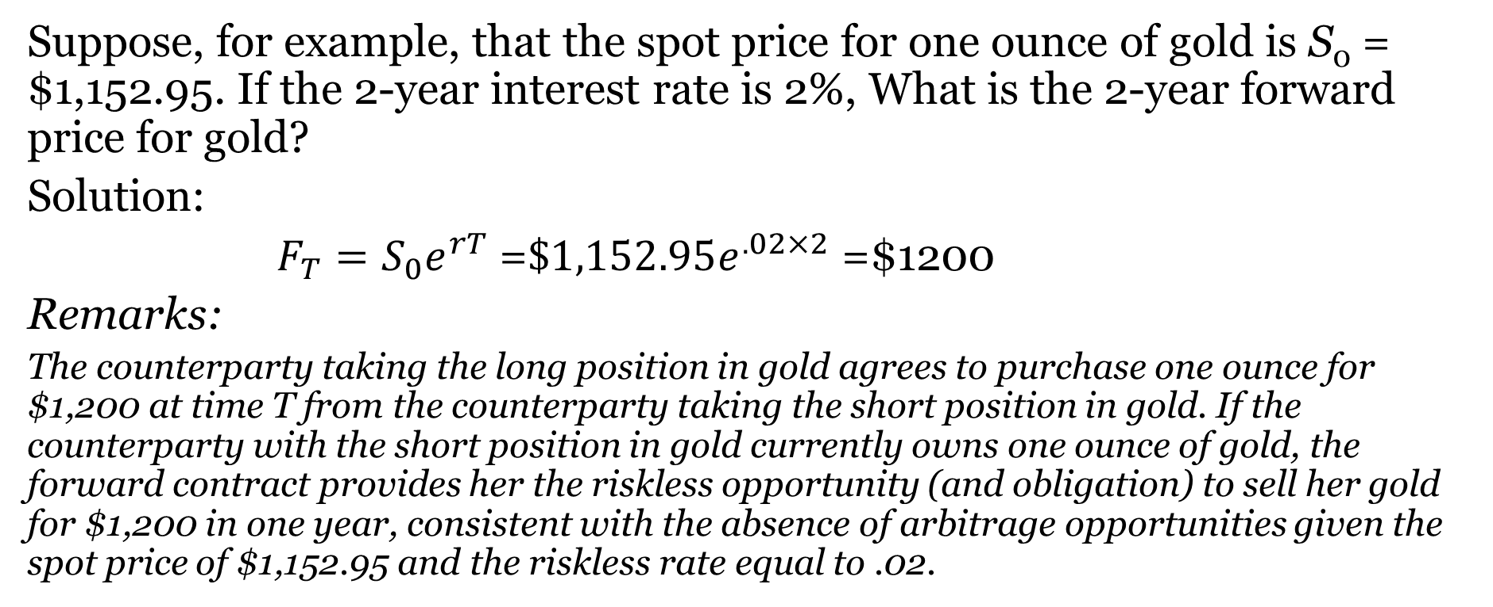
Illustration: Forward Contract
Suppose, for example, that the spot price for one ounce of gold is S₀ = $1,152.95. If the 2-year interest rate is 2%, What is the 2-year forward price for gold?
Solution:
$F_{T}=S_{0}e^{rT}$ =$\$1,152.95e^{.02×2}$ =$1200
Remarks:
The counterparty taking the long position in gold agrees to purchase one ounce for $1,200 at time T from the counterparty taking the short position in gold. If the counterparty with the short position in gold currently owns one ounce of gold, the forward contract provides her the riskless opportunity (and obligation) to sell her gold for $1,200 in one year, consistent with the absence of arbitrage opportunities given the spot price of $1,152.95 and the riskless rate equal to .02.

Slide 4
Contango
Contango: when futures prices are higher than the spot prices
Common in markets in which:
  commodities are not consumed
  current demand is not high relative to anticipated demand
Enables traders who are net long in spot markets and short in forward or futures contracts to obtain riskless returns

Slide 5
Contango: Possible Causes
Contango may derive from hedgers paying premiums to lock in purchase prices for the underlying asset
Other forces that might drive contango:
  high carry costs
  high time value of money or interest rates

Slide 6
Cash Price vs. Futures Price: November Silver Contract in Contango Market

Slide 7
Different Persepctive
Now, let’s look at a contango market from a different perspective.

Slide 8
Gold Futures, per Ounce, Dec. 7, 2020

Slide 9
The Gold Futures Curve: December, 2020 to June 2026 in Contago

Slide 10
Backwardation
Backwardation occurs when the futures price is less than the spot price
Backwardation might suggest that investors expect the underlying asset price to fall over time; e.g., bad weather during a growing season
The process of convergence of higher forward prices to lower spot prices is known as normal backwardation or simply backwardation.

Slide 11
Backwardation: Possible Causes
Backwardation implies that investors who own the commodity pay to do so, perhaps because:
  commodity is to be consumed
  is in high current demand or shortage
  if the underlying makes a payment (such as a dividend for a stock or ETF)
Another investor with a long position in a forward or futures contract does not have to pay the storage cost, and can hold money instead, but would not receive any ownership benefits.

Slide 12
Cash Price vs. Futures Price: November ETF Contract in Backwardation Market

Slide 13
Forward Market Complications
Dividends
Foreign Exchange
Carry Costs

Slide 14
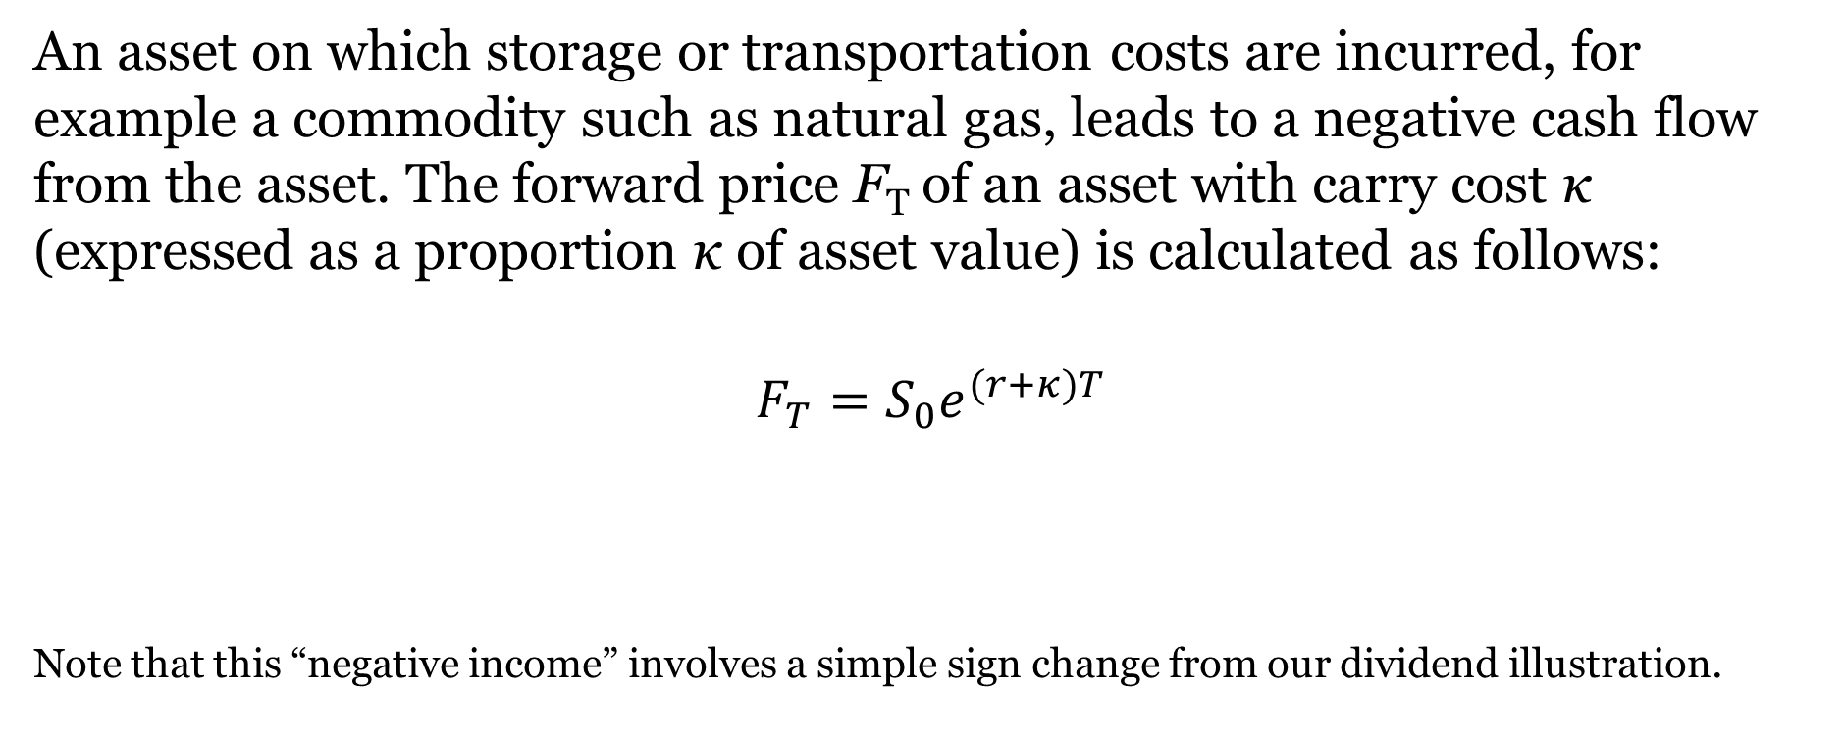
Carry Costs
An asset on which storage or transportation costs are incurred, for example a commodity such as natural gas, leads to a negative cash flow from the asset. The forward price F_{T} of an asset with carry cost κ (expressed as a proportion κ of asset value) is calculated as follows:
$$F_{T}=S_{0}e^{(r+κ)T}$$
Note that this “negative income” involves a simple sign change from our dividend illustration.

Slide 15
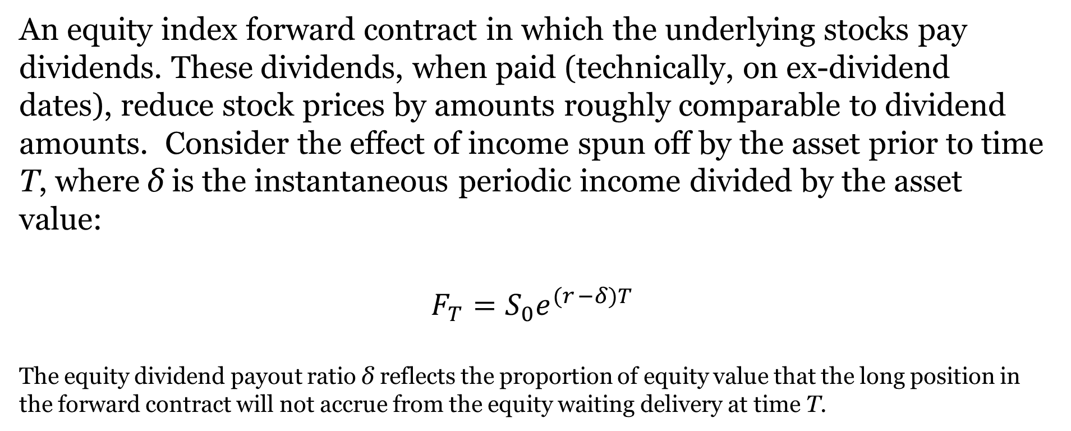
Dividends
An equity index forward contract in which the underlying stocks pay dividends. These dividends, when paid (technically, on ex-dividend dates), reduce stock prices by amounts roughly comparable to dividend amounts. Consider the effect of income spun off by the asset prior to time T, where δ is the instantaneous periodic income divided by the asset value:
$$F_{T}=S_{0}e^{(r_{ }−δ)T}$$
The equity dividend payout ratio δ reflects the proportion of equity value that the long position in the forward contract will not accrue from the equity waiting delivery at time T.

Slide 16
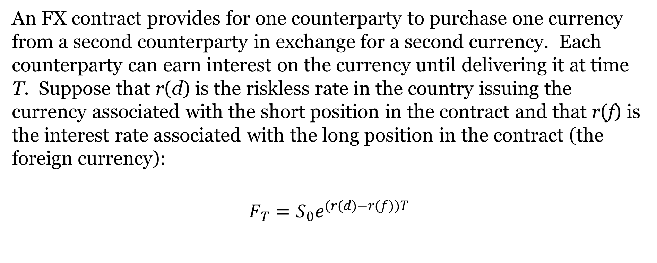
Foreign Exchange
An FX contract provides for one counterparty to purchase one currency from a second counterparty in exchange for a second currency. Each counterparty can earn interest on the currency until delivering it at time T. Suppose that r(d) is the riskless rate in the country issuing the currency associated with the short position in the contract and that r(f) is the interest rate associated with the long position in the contract (the foreign currency):
$$F_{T}=S_{0}e^{(r(d)−r(f))T}$$

Slide 17
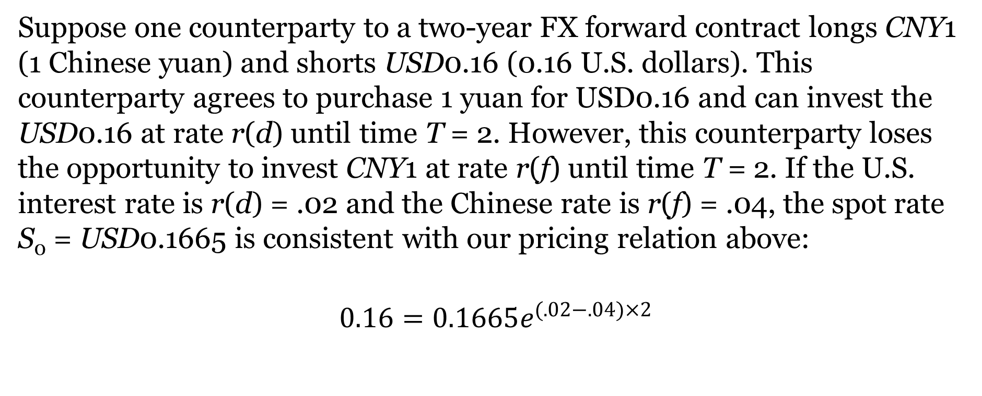
Interest Rate Parity
Suppose one counterparty to a two-year FX forward contract longs CNY1 (1 Chinese yuan) and shorts USD0.16 (0.16 U.S. dollars). This counterparty agrees to purchase 1 yuan for USD0.16 and can invest the USD0.16 at rate r(d) until time T = 2. However, this counterparty loses the opportunity to invest CNY1 at rate r(f) until time T = 2. If the U.S. interest rate is r(d) = .02 and the Chinese rate is r(f) = .04, the spot rate S₀ = USD0.1665 is consistent with our pricing relation above:
$$0.16=0.1665e^{(.02−.04)×2}$$

Slide 18

Interest Rate Parity: Discrete Time
Describes an international currency market equilibrium
Violation is expected to result in a shift in:
  one or both of the affected interest rates
  forward or spot prices of affected currencies
  or some combination thereof

Slide 19

Interest Rate Parity Illustration
Exchange rates of USD for GBP are 1.6 and 1.629629 in spot and one-year forward markets, respectively.
Assume that nominal interest rates are 12.5% in the U.S. and 12% in the U.K.
We will be able to demonstrate an arbitrage opportunity because:

Slide 20
Arbitrage Transactions
1. Borrow $1000 now in the U.S. at 12.5%; repay at Time One
2. Buy £625 now for $1000
3. Loan £625 at 12%; Collect £700 in proceeds at Time One
4. Sell £700 at Time One at F1=1.629629 for $1140.74;
5. Repay $1125 in U.S. debt

Slide 21
Arbitrage Portfolio Positions

