Slide 1
Chapter 7
Stochastic Processes: Introduction for Option Pricing

Slide 2
A. Random Walks and Martingales
Stochastic process: A sequence of random variables X_{t} defined on a common probability space (Ω,Φ,P) and indexed by time t
The values of X_{t}(ω) define the sample path of the process leading to state ω∈Ω. The terms X(ω,t) and X_{t}(ω) are synonymous.
A discrete time process is defined for a finite set of time periods; a continuous time process that is defined over an infinite number of periods.
The state space is the set of values in process {X_{t}}:
X = {X_{t}(ω) for some ω ∈ Ω and some t}

Slide 3
The σ-algebra and Filtrations
For our purposes, we can characterize a σ-algebra as the collection of sets of events, including all complements and unions thereof.
A filtration is a sequence of information sets indexed over time, so that each information set contains the required history for valuation at that time.

Slide 4


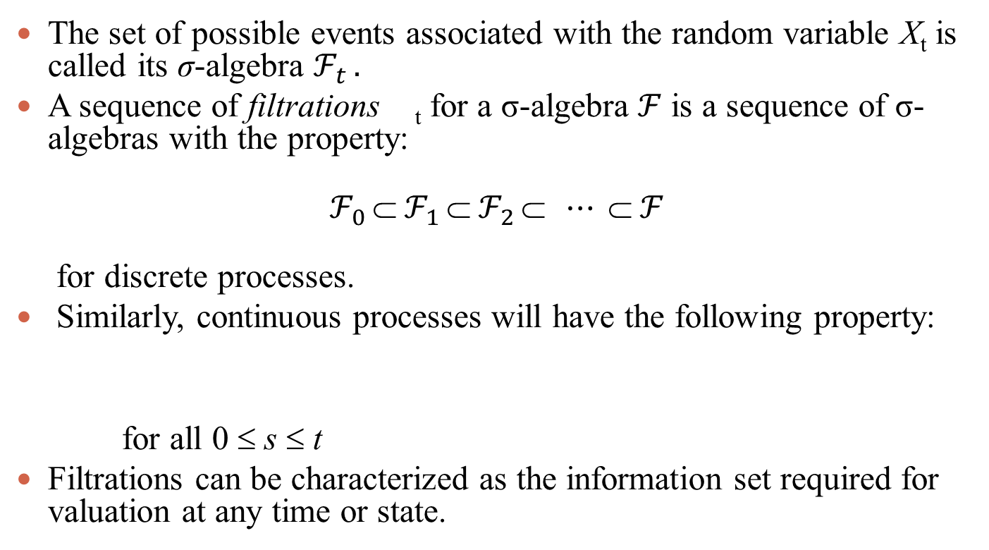
σ-algebra and Filtration Properties
The set of possible events associated with the random variable X_{t} is called its σ-algebra $ℱ_{t }.$
A sequence of filtrations _{t} for a σ-algebra $ℱ$ is a sequence of σ-algebras with the property:
$$ℱ_{0 } ℱ_{1 } ℱ_{2 } ⋯  ℱ_{ }$$
for discrete processes.
Similarly, continuous processes will have the following property:
for all 0 ≤ s ≤ t
Filtrations can be characterized as the information set required for valuation at any time or state.
$$ℱ$$

Slide 5
Illustration: The Sample Space in a Two Period Random Walk
The sample space for a simple binomial process over two periods is:
Ω = {(1,1), (1,-1), (-1,1), (-1,-1)}.

Slide 6

Illustration: The σ-algebra in a Two Period Random Walk
The time zero σ-algebra consists simply of:
The time one σ-algebra expands to:

Slide 7
Random Walks and Markov Processes
Random walk: A stochastic process with independent increments.
Markov Process: A stochastic process in which to make predictions of its future given its past is equivalent to basing the predictions only on its present state. A Markov Process has no memory:
$$P\left(X_{t} | X_{0},X_{1},…,X_{s}\right)=P\left(X_{t} | X_{s}\right) ∀s<t$$

Slide 8
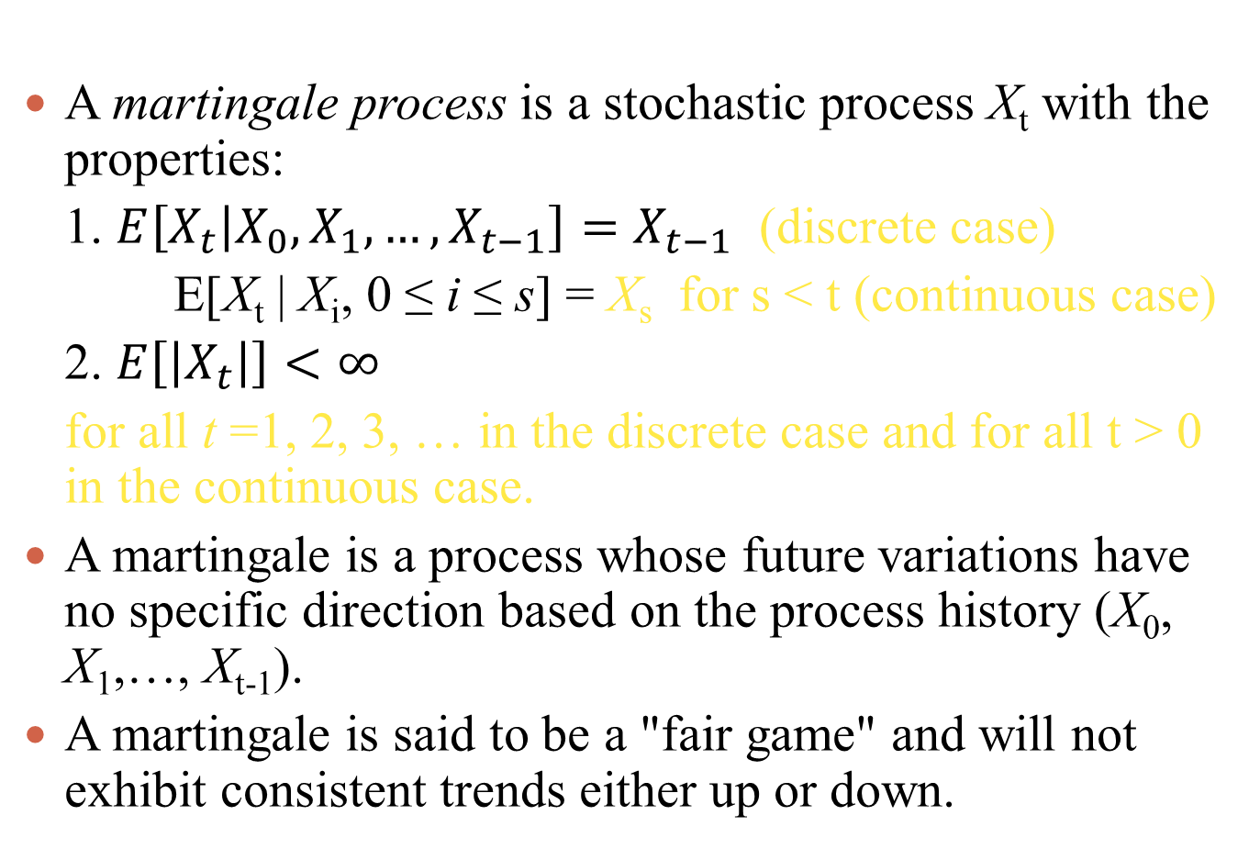
Martingales

Slide 9
Submartingales and Super Martingales
A submartingale with respect to probability measure ℙ is a stochastic process X_{t} in which:
E_{ℙ}[X_{t}⏐X₀, X₁, X₂, ..., X_{t-1}] ≥ X_{t-1}
in the discrete case and the analogous requirement in the continuous case.
A submartingale will tend either to trend upward over time or is a martingale. The definition of a supermartingale replaces the greater than or equal inequality above with a less than or equal inequality.
A supermartingale will tend to trend downward over time or is a martingale.

Slide 10
Equivalent Probabilities and Equivalent Martingale Measures
Prices of assets need not be functions of physical probabilities or expected values based on physical probabilities.
Risk neutral probabilities arise from the strongest of financial forces - arbitrage.
Risk-neutral probabilities do not strictly measure opinions of likelihood in the way that physical probabilities do.
However, they are essential to arbitrage-free pricing, and they can still be treated as probabilities for relative pricing purposes.

Slide 11
Numeraires
Thus far we have expressed all asset values in terms of dollars and returns relative to dollars. Thus, the dollar served as the numeraire.
However, we can just as easily express values in terms of other currencies, other securities such as pure securities as we did in Chapters 2 and 3 or riskless bonds.
Flexibility in selecting the numeraire and an associated equivalent martingale measure affords us the ability of being able to use valuation techniques that otherwise would not be available or would be more complicated.

Slide 12
Equivalent Probability Measures
A probability measure ℙ is a mapping from an event space such that all events ϕ have probabilities p[ϕ] ∈ [0, 1].
An equivalent probability measure ℚ has the same null space as ℙ.
Two probability measures are said to be equivalent (ℙ ~ ℚ) if the set of events that have probability 0 under measure ℙ is the same as that set under the second measure ℚ .
This implies that ℚ << ℙ (ℚ is absolutely continuous with respect to ℙ, which means that p(ϕ) = 0 ⇒ q(ϕ) =0) and ℙ << ℚ (ℙ is absolutely continuous with respect to ℚ; q(ϕ) = 0 ⇒ p(ϕ) =0).
This implies that an equivalent probability measure is consistent with respect to which outcomes are possible.
However, the actual non-zero probabilities assigned to events might differ.
If ℚ << ℙ and ℙ << ℚ, then ℚ ~ ℙ.

Slide 13
Equivalent Martingale Measures
A probability measure ℚ is an equivalent martingale measure (risk-neutral measure) to ℙ in a complete market if:
  ℚ and ℙ are equivalent probability measures, and
  The price of every security in the market (using the riskless bond as the numeraire) is a martingale with respect to the probability measure ℚ.
In a complete market in which there are no arbitrage opportunities, there will always exist a unique equivalent martingale measure.
This unique equivalent martingale measure can be used to obtain risk-neutral pricing for every security in that market.

Slide 14
Equivalent Martingale Measures: Observations
A complete market exists where every security can be expressed as a portfolio of priced pure securities.
Since the equivalent martingale measure ℚ is unique, one is free to choose any set of n linearly independent securities that form a basis for the market and that have been priced in order to construct the measure ℚ.
A market has a unique equivalent martingale measure if and only if it is both complete and arbitrage-free.

Slide 15
The Riskless Bond as the Numeraire
To use the riskless bond as the numeraire is equivalent to discounting the security by the riskless rate.
Since the discounted security price is a martingale, its expected value has the same return as the return on the riskless bond. If this were not the case, there would be an opportunity for arbitrage.

Slide 16
Pricing with Submartingales
We generally expect that securities will price as submartingales with respect to money because of the time value of money:
If there exists an equivalent probability measure ℚ such that discounted security prices can be converted into martingales, this will simplify valuation:

Slide 17
B. Binomial Processes: Characteristics and Modeling
A Bernoulli trial is a single random experiment with two possible outcomes (e.g., 0, 1, or u or d) whose outcomes depend on a probability.
We will define a binomial process to be any stochastic process based on a series of n statistically independent Bernoulli (0,1) trials, all with the same outcome probability.

Slide 18
Binomial Processes
Consider the Markov Process: X_{t} = X₀ + aZ₁ + aZ₂ +…+ aZ_{t} with
  Z_{t}(ω) = 1 if ω = u with probability p
  Z_{t}(ω) = -1 if ω = d with probability 1-p
  a is a positive constant
  Random variables Z_{t} are pairwise independent.
This process is like a random walk starting at X₀, taking a step of length a right with probability p and of length a left with probability 1 – p.
Under probability measure ℙ, the expected value of X_{t} at time t is:
Observe that X_{t} is a martingale when p = ½, a submartingale when p > ½, and a supermartingale when p < ½.
The process described here does not involve multiplicative factors or compounded returns.

Slide 19


Binomial Returns Process
Applies to returns rather than to prices
Allows for compounding of returns
Defined as follows:
Implies that:
The probability that exactly k upjumps occurred from time zero to time t equals:

Slide 20
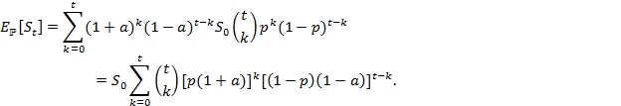
Expected Value of the Binomial Returns Process
Thus, the expected value of S_{t} given S₀ is:
Which, from the Binomial Theorem, implies:
And with multiplicative jumps u and d:

Slide 21
The Sample Space and Filtrations

Slide 22
Numerical Illustration
Suppose that we have the following in a binomial framework:
S0 = 10
n = 2
u = 1.5, d = .5
dt = .8, which implies that rf = 1.25
u, d and dt all imply that q = .75 and (1-q) = .25.
Why?

Slide 23






Because from Chapter 2
Since our 3X1 price kernel from the following, or its analog 2X1 vector in the following:
or
Which solves as follows:
, providing the pricing kernel,
then yields the equivalent martingale:
because and

Slide 24
Illustration: Binomial Outcome and Event Spaces

Slide 25
Pure Securities and Market Securities
Arrow-Debreu (pure) security prices, one associated with each starting and stopping node combination in our 2-time period model (See Figure 1 above).
First, we list spot (time 0) prices for investments extending from time 0 to time 1. Let ψ_{0,1;u} be the time zero price of a pure security that is worth 1 at time 1 if and only if an upjump occurs at time 1.
Letψ_{0,1;d} be the time zero price of a pure security that is worth 1 at time 1 if and only if a downjump occurs at time 1.
Subscripts before the semicolon refer to time periods, and subscripts after the semicolon refer to the occurrence of upjumps or downjumps.

Slide 26
Pure Securities and Market Securities (continued)
The vector [1 0]^{T} is the payoff from pure security 1 with an upjump occurring at time 1.
The vector [0 1]^{T} is the payoff from pure security 2 with a downjump occurring at time 1.
To purchase the stock at time 0 at a price of 10 means that at time 1 the portfolio owner takes payoff vector [15 5]^{T} because it will pay 15 if an upjump occurs and will pay 5 if a downjump occurs.

Slide 27




Valuing Time 1 Pure Securities
The time 0 price for payoff vector [1 0]^{T} is ψ_{0,1;u}
The time 0 price for payoff vector [0 1]^{T} is ψ_{0,1;d}
Therefore, time 0 value of the stock [15 5]^{T} is 10:
The time 0 price of the portfolio [1 1]^{T} is .8
Thus, time 0 pure security prices are ψ_{0,1;u} =.6 and ψ_{0,1;d} =.2: ;

Slide 28


Valuing Time 2 Pure Securities
The time 1 upjump price for payoff vector [1 0]^{T} is ψ_{1,2;u,u}
The time 1 upjump price for payoff vector [0 1]^{T} is ψ_{1,2;u,d}
These prices are calculated for time 1 from the following system:
The time 1 downjump price for payoff vector [1 0]^{T} is ψ_{1,2;d,u}
The time 1 downjump price for payoff vector [0 1]^{T} is ψ_{1,2;d,d}
These prices are calculated for time 1 from the following system:

Slide 29


Valuing Time 2 Pure Securities (Continued)
Time 2 pure securities are priced with the following systems:
Notice that ψ_{0,2;u,d} and ψ_{0,2;d,u} are combined, which is possible because they are recombined (reflect the same node) on the binomial lattice in Figure 1.

Slide 30


Valuing Securities from Time 2 Payoffs
We obtain time zero market prices based on time 2 stock and bond payoffs as follows:

Slide 31

Spot Market Bond Prices and Yields
Spot market bond prices and yields are computed as follows:

Slide 32
Forward Market Bond Prices and Yields
Forward market bond prices and yields are computed as follows:
Note that these prices and yields are contingent on time 1 outcomes.

Slide 33

The Equivalent Martingale Measure
Physical probabilities matter only to the extent that we can obtain their equivalent martingale measures.
Risk neutral probabilities are computed as follows:
For our example, q_{0,1;u}= ψ_{0,1;u} /B_{0,1}=.6/.8=.75,
q_{1,2;u,d}= ψ_{1,2;u,d} /B_{1,2}=.2/.8=.25, and
q_{0,2;d,d}= ψ_{0,2;d,d} /B_{0,2}=.04/.64=.0625

Slide 34

Change of Numeraire and Martingales
The numeraire is the unit in which values are expressed.
We calculate risk neutral probabilities and the expected value of the stock with respect to our numeraire (the bond) as follows:
E_{ℚ}[S_{0,1}|S₀/B₀] = 12.5 = S₀/B₀
Since the time-zero expected value of the stock at time 1 (given the time-zero stock value in bond numeraire) under the probability measure ℚ equals the time-zero stock value (in bond numeraire), then the stock price has the martingale property at time 1.
We can demonstrate similar martingale properties going from time 1 to time 2, and from time 0 to time 2. Thus, in this two time period process, the probability measure ℚ is an equivalent martingale measure to ℙ.

Slide 35
Change of Numeraire and Martingales (continued)
If we convert from the bond numeraire back to the original currency (dollars), we get the time 0 prices.
The time-zero value of the stock is 12.5 times that of the bond, which is .8 dollars:

Slide 36


Binomial Pricing, Change of Numeraire and Martingales
To summarize, we price the stock and the bond as follows:

Slide 37
Two-Period Binomial Model

Slide 38
C. Brownian Motion and Itô Processes
A process Z_{t} is a standard Brownian motion process (or Wiener process) if:
  Changes in Z_{t} over time are independent over disjoint intervals of time; that is, COV(Z_{s}-Z_{t}, Z_{u}-Z_{v},) = 0 when s > t > u > v.
  Changes in Z_{t} are normally distributed with E[Z_{s}-Z_{t}] = 0 and E[(Z_{s}-Z_{t})²] = s - t for s > t. Thus, Z_{s} - Z_{t} ~ N(0, s-t) with s > t.
  Z_{t} is a continuous function of t.
  The process begins at zero, Z₀ = 0.

Slide 39
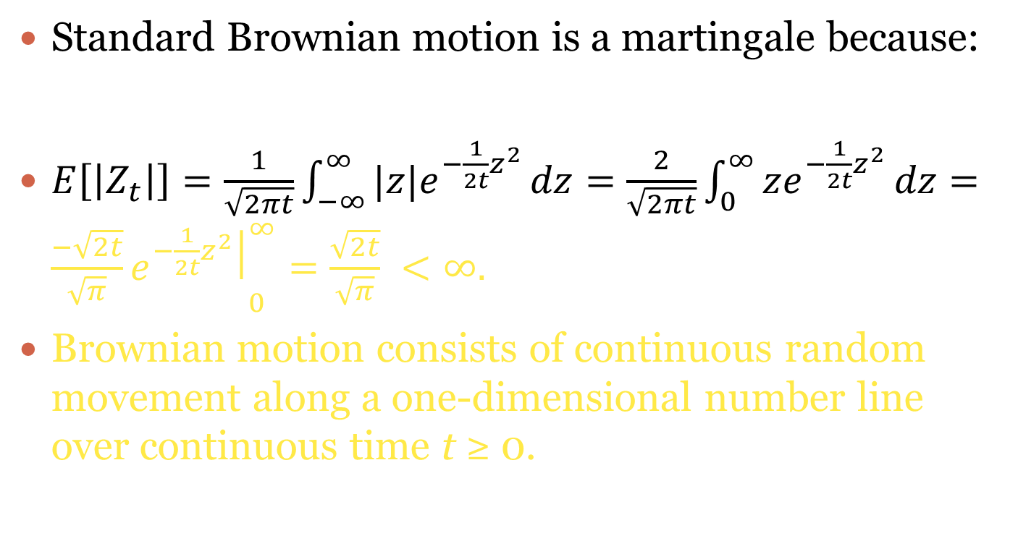
Standard Brownian Motion and Martingales
Standard Brownian motion is a martingale because:
$E\left[\left|Z_{t}\right|\right]=\frac{1}{\sqrt{2πt}}\int_{−∞}^{∞}{|z|e^{−\frac{1}{2t}z^{2}}}dz=\frac{2}{\sqrt{2πt}}\int_{0}^{∞}{ze^{−\frac{1}{2t}z^{2}}}dz={\frac{−\sqrt{2t}}{\sqrt{π}}\left.e^{−\frac{1}{2t}z^{2}}\right|}_{0}^{∞}=\frac{\sqrt{2t}}{\sqrt{π}} <∞.$
Brownian motion consists of continuous random movement along a one-dimensional number line over continuous time t ≥ 0.

Slide 40
Brownian Motion
The z-axis for Brownian motion Zt and time axis allow for Zt to fluctuate about the z-axis in a random but continuous way.
A specific history ω in the sample space Ω for Brownian motion results in a particular Brownian motion path Zt(ω).
One can graph Brownian motion Zt(ω) versus time t for a specific history ω. See the next slide for the graph:

Slide 41
Brownian Motion (continued)
Z_{t}

Slide 42
Brownian Motion Characteristics
Brownian motion is continuous everywhere and differentiable nowhere
  B-m never smooths under Newtonian calculus
  This is because along any interval of time Δt, the change in height of the Brownian motion, Z_{t+Δt} – Z_{t}, is on the order of its standard deviation, which equals . Thus, (Z_{t+Δt} – Z_{t})/Δt is on the order of , which approaches infinity as Δt → 0.
  This means that the average rate of change of Brownian motion over any time interval approaches infinity as the width of the time interval approaches zero.
  Thus, we see in Figure 3 that Brownian motion is a fractal
Once a Brownian motion hits a given value, it will return to that value infinitely often.

Slide 43
Brownian Motion: Illustration
A stock price S_{t} follows a Brownian motion process with:
S0 = $50 σ² = 4.
Find the probability that the S3 < $56
Since S_{t} ~ N(50, 4t), then S₃ ~ N(50, 12).
Using a standard z-Table, we find this probability :

Slide 44
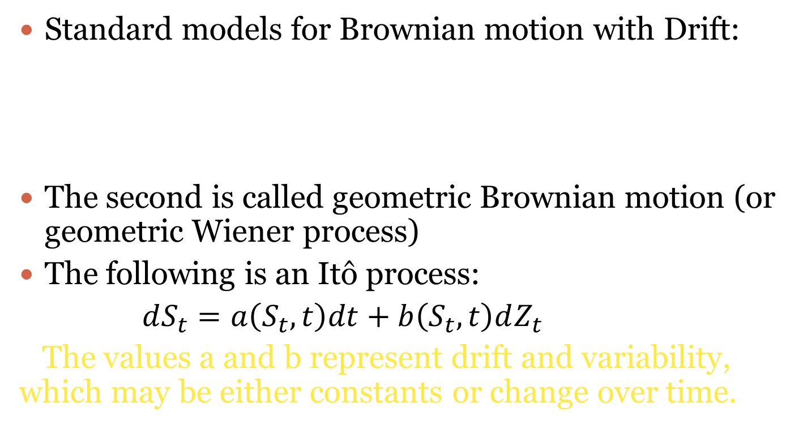
Brownian Motion Processes with Drift
Standard models for Brownian motion with Drift:
The second is called geometric Brownian motion (or geometric Wiener process)
The following is an Itô process:
$dS_{t}=a\left(S_{t},t\right)dt+b\left(S_{t},t\right)dZ_{t}$
The values a and b represent drift and variability, which may be either constants or change over time.

Slide 45


D. Option Pricing: A Heuristic Derivation of Black Scholes
The expected future value of the call is:

Slide 46


The Stock Price Process in a Black-Scholes Environment
Assume that the stock price follows a geometric Brownian motion process:
or:

Slide 47
Estimating Exercise Probability in a Black-Scholes Environment

Slide 48



The Expected Expiry Date Call Value
The following calculates the expected value of the call contingent on its exercise:
With new random variable , we have:

Slide 49

The Expected Expiry Date Call Value, cont.
With d₁ = d₂ + σ , the expected expiry date call value equals:
And we discount to get the Black-Scholes model:

Slide 50

Observations Concerning N(d₁) and N(d₂)
The probability that the stock price at time T will exceed the exercise price X of the call is P[S_{T} > X] = N(d₂).
The expected value of the stock conditional on the stock's price S_{T} exceeding the exercise price of the call is:

Slide 51

Observations Concerning c_{T} and c₀
The expected expiry date call value is simply the product of the probability of call exercise and the expected value of the stock conditional on the stock's price exceeding the exercise price of the call, minus the expected exercise price paid at time T:
The present value of the call is simply the discounted value of its expected future value:

