Slide 1
Chapter 10
The Black-Scholes Model

Slide 2
A. Preliminaries
Here, we build on the mathematics of the last chapter to derive the Black-Scholes option pricing model.
We will employ the analytical approach of Black and Scholes themselves, where the option value is the solution to the appropriate boundary value problem.

Slide 3
Self-Financing Strategies and Portfolios
We will reintroduce the self-financing replicating portfolio and how to use it to price derivatives.
We will assume a market consisting of a stock and a riskless bond that will be used to create the portfolio.
A portfolio (γ_{s,t,}, γ_{b,t}) is a self-financing replicating portfolio for the call if and only if the following two properties are satisfied:
I (self-financing)
II (replicating the call)

Slide 4
Introducing the Self-Financing Replicating Portfolio
Our self-financing arbitrage portfolio will short one call, long γ_{s,t} shares of stock and short γ_{b,t} units of the riskless bond (γ_{b,t} will be negative):

Slide 5
B. Deriving the Black-Scholes Model
Here, we will derive a pricing model for a call using a self-financing replicating portfolio.
The derivation that we provide here is essentially the same as discussed by Black and Scholes [1973].

Slide 6
Black-Scholes Assumptions
There exist no restrictions on short sales of stock or writing of call options.
There are no transactions costs.
There exists continuous trading of stocks and options.
There exists a known constant riskless borrowing and lending rate r.
The underlying stock will pay no dividends or make other distributions during the life of the option.
The option can be exercised only on its expiration date; that is, it is a European Option.
Shares of stock and option contracts are infinitely divisible.
Underlying stock prices follow a geometric Brownian motion process:
dS_{t} = μS_{t}dt + σS_{t}dZ_{t}.

Slide 7
Inputs not Needed
The expected or required return or risk premium on the stock or option and
Investor attitudes toward risk

Slide 8
Self-Financing Strategies and Portfolios
Remember that a portfolio (γ_{s,t,}, γ_{b,t}) is a self-financing replicating portfolio for the call if and only if the following two properties are satisfied; we rewrite the properties as well for some needed algebra:
I (self-financing)
II (replicating the call)

Slide 9

Itô’s Lemma and Geometric Brownian Motion
Remember that the stock follows a geometric Brownian motion process:
Remember our differential equation (Property I) from previous slide:
Now, we will invoke Itô’s Lemma from Chapter 9 to express the differential dc_{t}:

Slide 10
Setting up for the Hedge Ratio
On the previous slide, the last part of the second equation and the third equation imply:
And, substituting the stock price differential:
Then, regrouping terms:

Slide 11

Getting the Black Scholes Differential Equation
The key insight of Black and Scholes: Realizing that a perfect instantaneous hedge can be created with a single call and an opposite position in shares of stock.
Our equation on the previous slide simplifies to:
Or, canceling dt, allowing S to be known and rearranging terms:

Slide 12
The Black Scholes Differential Equation
This is the Black-Scholes differential equation:
A step-by-step derivation for the solution of this equation is provided in the appendix to Chapter 10, but does not provide much insight into the model.
Notice that this Equation makes no reference to μ, suggesting that our pricing model will not depend on a risk premium or investor risk preferences.
The solution or model itself is quite easy to set up, apply and interpret.

Slide 13
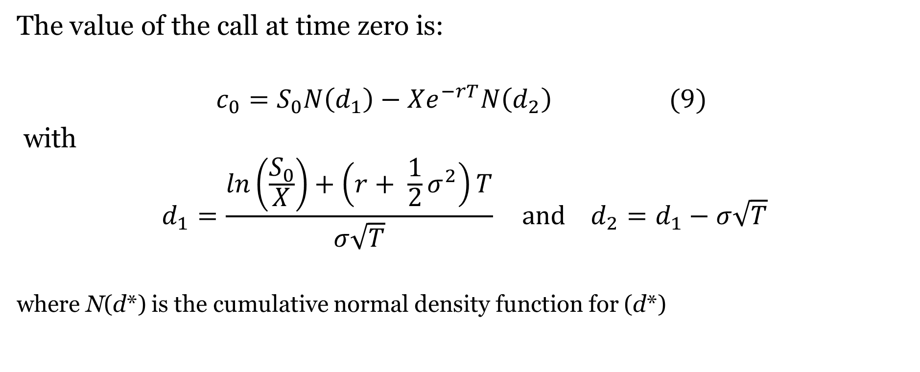
The Solution To The Black-Scholes Differential Equation
The value of the call at time zero is:
$$c_{0}=S_{0}N\left(d_{1}\right)−Xe^{−rT}N\left(d_{2}\right) (9)$$
with
$$d_{1}=\frac{\ln\left(\frac{S_{0}}{X}\right)+\left(r+ \frac{1}{2}σ^{2}\right)T}{σ\sqrt{T}} and d_{2}=d_{1}−σ\sqrt{T}$$
where N(d*) is the cumulative normal density function for (d*)
Note: For the interested reader, a derivation of the solution is in the text website for this chapter

Slide 14
The Black-Scholes Model: A Simple Numerical Illustration
Consider the following example of a Black-Scholes model application where an investor can purchase a six-month call option for $7.00 on a stock that is currently selling for $75. The exercise price of the call is $80 and the current riskless rate of return is 10% per annum. The variance of annual returns on the underlying stock is 16%. At its current price of $7.00, does this option represent a good investment?
We will note the model inputs in symbolic form:
T = .5 r = .10 X = 80 σ² = .16 σ = .4 S₀ = 75
Our first step is to find d₁ and d₂:
.

Slide 15
The Black-Scholes Model: A Simple Numerical Illustration (Continued)
Next, by using a z-table we find cumulative normal density functions for d₁ and d₂:
Finally, we use N(d₁) and N(d₂) to value the call:

Slide 16
Put-Call Parity
Call and put Payoff functions:
p_{T} = MAX[0, X – S_{T}]
Subtract and re-write:
c_{T} - p_{T} = MAX[0, S_{T} - X] - MAX[0, X – S_{T}] = S_{T} - X
p_{T} = c_{T} + X – S_{T}

Slide 17
The Black-Scholes Model: A Simple Numerical Illustration (Continued)
Since the 7.958 value of the call exceeds its 7.00 market price, the call represents a good purchase. Next, we use the put-call parity relation to find the value of the put as follows:
p₀ = c₀ + Xe^{-rT} - S₀
p₀ = 7.958 + 80(.9512) - 75 = 9.054

Slide 18
C. Implied Volatility
4 of 5 inputs required for Black-Scholes model are easily observed.
X and T are defined by the option contract.
r and S0 are based on current quotes.
Only σ, the underlying stock return volatility during the life of the option, cannot be observed.
Thus, we often employ a traditional sample estimator for return variance:
σ² = Var[r_{t}] = Var[lnS_{t} - lnS_{t-1}]
The difficulty with this procedure is that it requires that we assume that underlying security return variance is stable over time; more specifically, that future variances equal or can be estimated from historical variances.

Slide 19
Implied Volatility is Based on Market Prices
An alternative procedure first suggested by Latane and Rendleman [1976] is based on market prices of options that might be used to imply variance estimates.
The Black-Scholes Option Pricing Model might provide an excellent means to estimate underlying stock variances if the market prices of one or more relevant calls and puts are known.
Essentially, this procedure determines market estimates for underlying stock variance based on known market prices for options on the underlying securities.
When we use this procedure, we assume that the market reveals its estimate of volatility through the market prices of options.

Slide 20
Implied Volatility Illustration
Consider the following example pertaining to a six-month call currently trading for $8.20 and its underlying stock currently trading for $75:
T = .5 r = .10 c₀ = 8.20 X = 80 S₀ = 75
If investors use the Black-Scholes Options Pricing Model to value calls, the following should be expected:

Slide 21
Implied Volatility: Starting the Search Process
Unfortunately, the system of equations required to obtain an implied variance has no closed form solution.
That is, we will be unable to solve this equation set explicitly for standard deviation; we must search, iterate and substitute for a solution.
One can substitute trial values for σ until she finds one that solves the system.
A significant amount of time can be saved by using one of several well-known numerical search procedures such as the Method of Bisection or the Newton-Raphson Method

Slide 22
The Method Of Bisection
We seek to solve the above system of equations for σ. This is equivalent to solving for the root of:
f(σ*) = 0 = 75×N(d₁) – 80×e^{-.1×.5}×N(d₂) - 8.20
based on equations above for d₁ and d₂.
There exists no closed form solution for σ. Thus, we will use the Method of Bisection to search for a solution.

Slide 23
The Method Of Bisection: Starting the Iteration
We first arbitrarily select endpoints for our range of guesses, such as b₁=.2 and a₁=.5 so that f(b₁) = -4.46788 < 0 and f(a₁) = 1.860465 > 0.
Since these endpoints result in f(σ) with opposite signs, our first iteration will be in the middle: σ₁ = .5(.2+.5) = .35.
We find that this estimate for σ results in a value of -1.29619 for f(σ). Since this f(σ) is negative, we know that σ* is in the segment b₂=.35 and a₂=.5.
Moving to Row n=2 on the next slide, we repeat the iteration process, finding after 16 iterations that σ*=.41146. Table 1 details the process of iteration.

Slide 24
The Method Of Bisection: Iterations
Using the Bisection Method to Estimate Implied Volatility

Slide 25
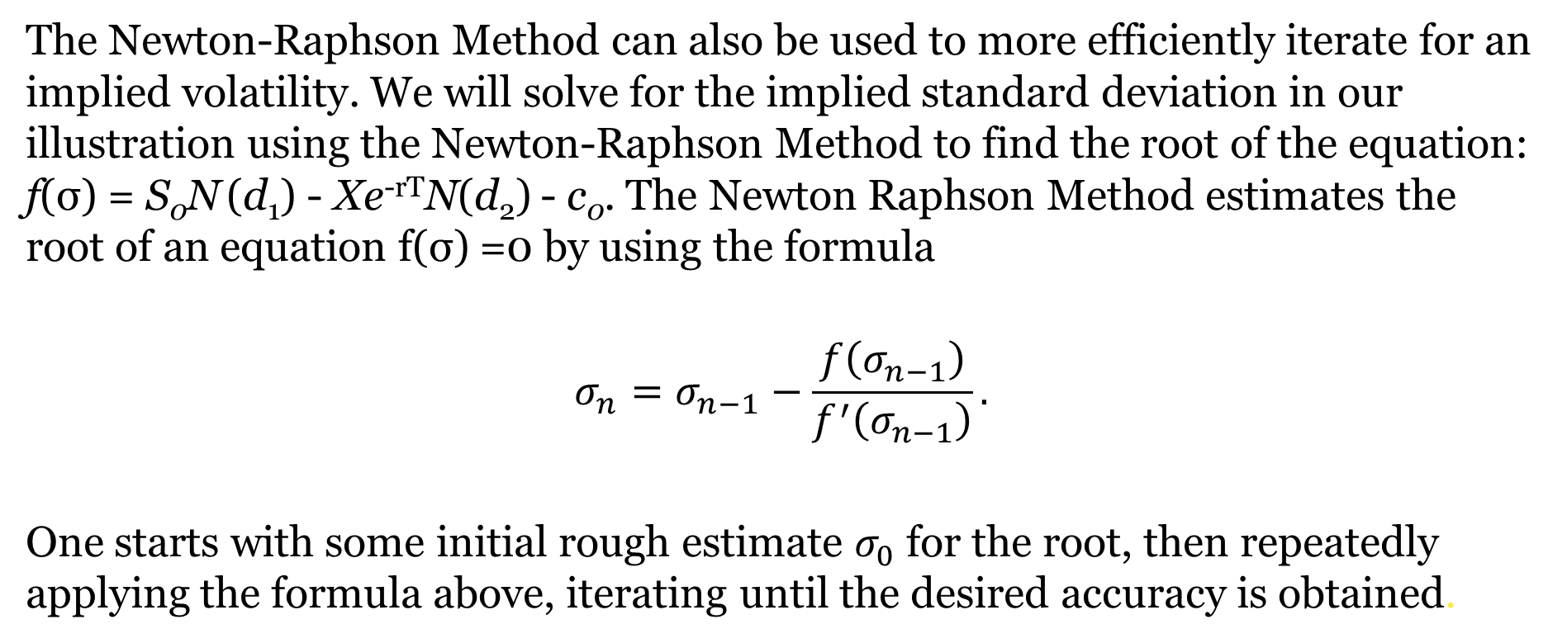
The Newton-Raphson Method
The Newton-Raphson Method can also be used to more efficiently iterate for an implied volatility. We will solve for the implied standard deviation in our illustration using the Newton-Raphson Method to find the root of the equation: f(σ) = S₀N (d₁) ‑ Xe^{‑rT}N(d₂) - c₀. The Newton Raphson Method estimates the root of an equation f(σ) =0 by using the formula
$$σ_{n}=σ_{n−1}−\frac{f\left(σ_{n−1}\right)}{f^{′}\left(σ_{n−1}\right)}.$$
One starts with some initial rough estimate $σ_{0}$ for the root, then repeatedly applying the formula above, iterating until the desired accuracy is obtained.

Slide 26
The Newton-Raphson Method : Vega and First Attempt
For our example, we arbitrarily choose an initial trial solution of σ = σ₀ = .6. First, we need the derivative of f(σ) with respect to the underlying stock return standard deviation σ. Since we are treating c₀ as a given constant, differentiating this function is equivalent to differentiating the call function c = S₀N (d₁)‑Xe^{‑rT}N(d₂) with respect to σ.
We selected initial trial solution of σ₀ = .6. We see from Table 2 that this standard deviation results in a value of f(σ₀) = 3.95012, implying a variance estimate that is too high. Substituting .6 into Equation 3 for σ₀, we find that f '(σ₀) = 20.82509. Thus, our second trial value for σ is determined by: σ₁ ≈ σ₀ - (f(σ₀) ÷ f '(σ₀)) = .6 - (3.95012 ÷ 20.82509) = .41032. This process continues until we converge to a solution of approximately .41147

Slide 27
The Newton-Raphson Method: Iterations
Notice that the rate of convergence in this example is much faster when using the Newton-Raphson Method than when using the Method of Bisection.

Slide 28
Smiles and Smirks
We see that with an appropriate iteration methodology, solving for implied volatility is not a difficult matter.
However, another difficulty arising with implied variance estimates results from the fact that there will typically be more than one option trading on the same stock.
What if the short- and long-term uncertainty of a stock differ?
Or, what if options with different strike prices disagree on the same underlying stock volatility?
This latter effect in which implied volatilities vary with respect to option exercise prices is sometimes known as the smile or smirk effect.

Slide 29
Smiles and Smirks in the X Space

Slide 30
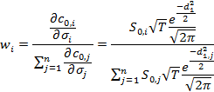

Aggregating Procedures
Two methodologies for averaging implied standard deviation estimates:
Simple average
Weighted Average based on price sensitivities to σ: Calls that are more sensitive to σ as indicated by ∂c/∂σ are more likely to imply a correct standard deviation estimate.
Thus, the final standard deviation estimate for a given stock based on all of the implied standard deviations from each of the call prices is:

Slide 31
D. Empirical Evidence
Does the Black-Scholes model do a reasonable job explaining how investors price options?
Numerous empirical tests yield evidence on this issue, generally finding that the model does work quite well explaining the pricing structure of stock options.
However, the tests do reveal some biases.

Slide 32
Black and Scholes [1972] Tests
Black and Scholes [1972] conducted the first test of their model on OTC dividend-protected contracts.
Using historical data, they back-tested hedge portfolios for excess returns.
Their hedge portfolios consisted of - shares of stock per call position.
Excess returns on hedge portfolios were calculated as:
They found that their model worked best for medium maturity at-the-money calls.
They found that both market prices and model prices contained information lacking in the other.

Slide 33
Galai [1977]
Galai [1977] used daily CBOE data from 4-26-1973 to 11-30-1973.
He adjusted hedges on a daily basis with options transactions, not stock transactions like Black Scholes.
Galai found that the Black Scholes Model resulted in significant excess returns before transactions costs but that transactions costs (at 1%) exceeded excess returns.
His results held given changes in variances and risk-free rates, but that higher dividend yield stock options yielded lower profits.
This result may simply reflect that Black Scholes assumes no dividends.

Slide 34
Bhattacharya [1980] also found that Black Scholes Model prices were appropriate most of the time.
Bhattacharya structured hedge portfolios based on simulated Black-Scholes values and found only one significant systematic case of mis-pricing - with at the money options whose prices were too high at expiration.

Slide 35
MacBeth and Merville [1979]
MacBeth and Merville [1979] studied implied volatilities on all options on six stocks in 1975-76 and found:
  Black Scholes prices are too low for in the money options and too high for out of the money options.
  Mispricing worsens as the option is further in or out of the money.
  Mispricing worsens as the time to expiration of the option increases.
Results imply that in the money options are overpriced in the market relative to out of the money options if we accept Black-Scholes as correct.
Market prices become more in line with Black-Scholes as expiration draws near.

Slide 36
Put-Call Parity
Klemkosky and Resnick [1979] tested the Put-Call Parity relation on 606 hedges, considering both short and long hedge portfolios and assuming non-stochastic dividends.
Their results were consistent with the Put-Call Parity Theorem, finding that profits were generally within the bounds associated with transactions costs.

