Slide 1
Chapter 11
The Greeks, Dividend Adjustments and Early Exercise

Slide 2
A. The Greeks
Delta
Gamma
Theta
Vega
Rho

Slide 3
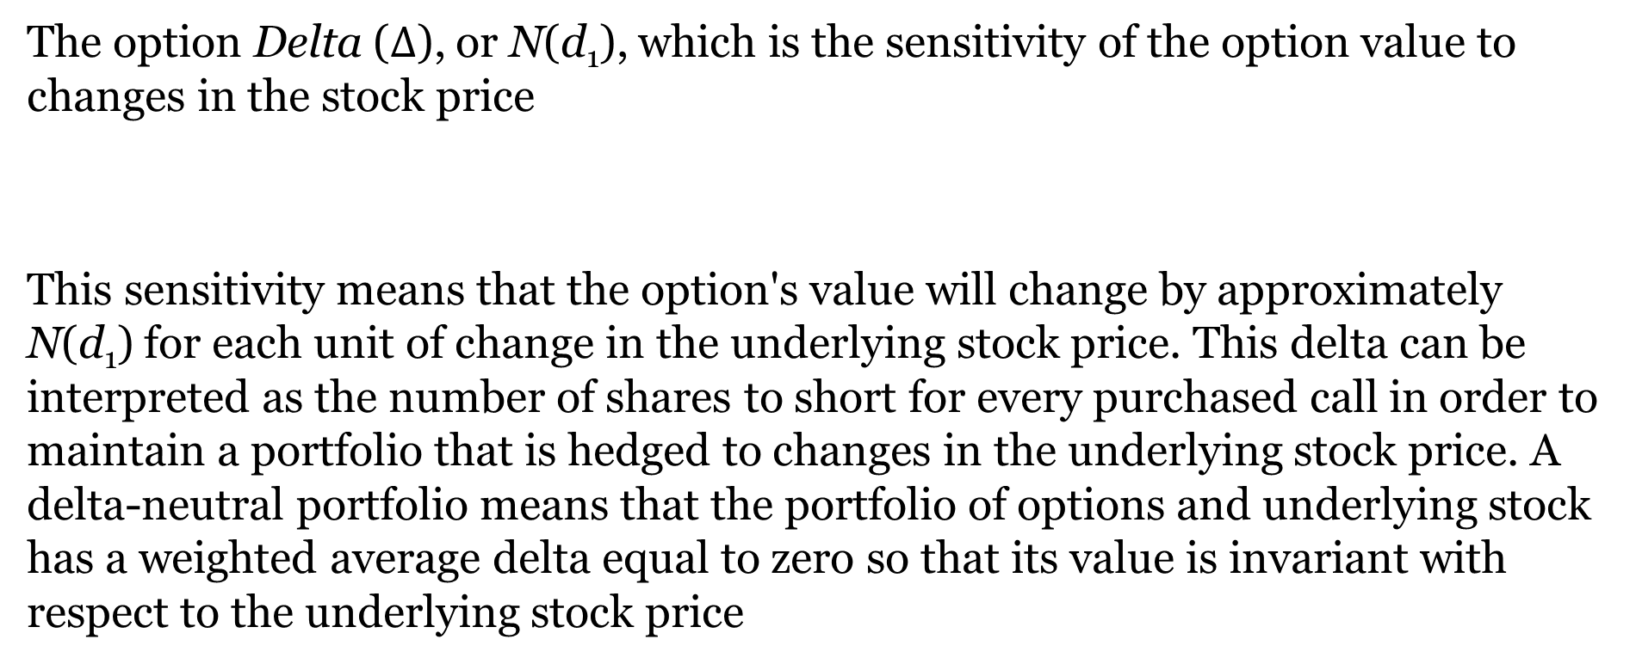
Delta
The option Delta ($∆$), or N(d₁), which is the sensitivity of the option value to changes in the stock price
This sensitivity means that the option's value will change by approximately N(d₁) for each unit of change in the underlying stock price. This delta can be interpreted as the number of shares to short for every purchased call in order to maintain a portfolio that is hedged to changes in the underlying stock price. A delta-neutral portfolio means that the portfolio of options and underlying stock has a weighted average delta equal to zero so that its value is invariant with respect to the underlying stock price

Slide 4
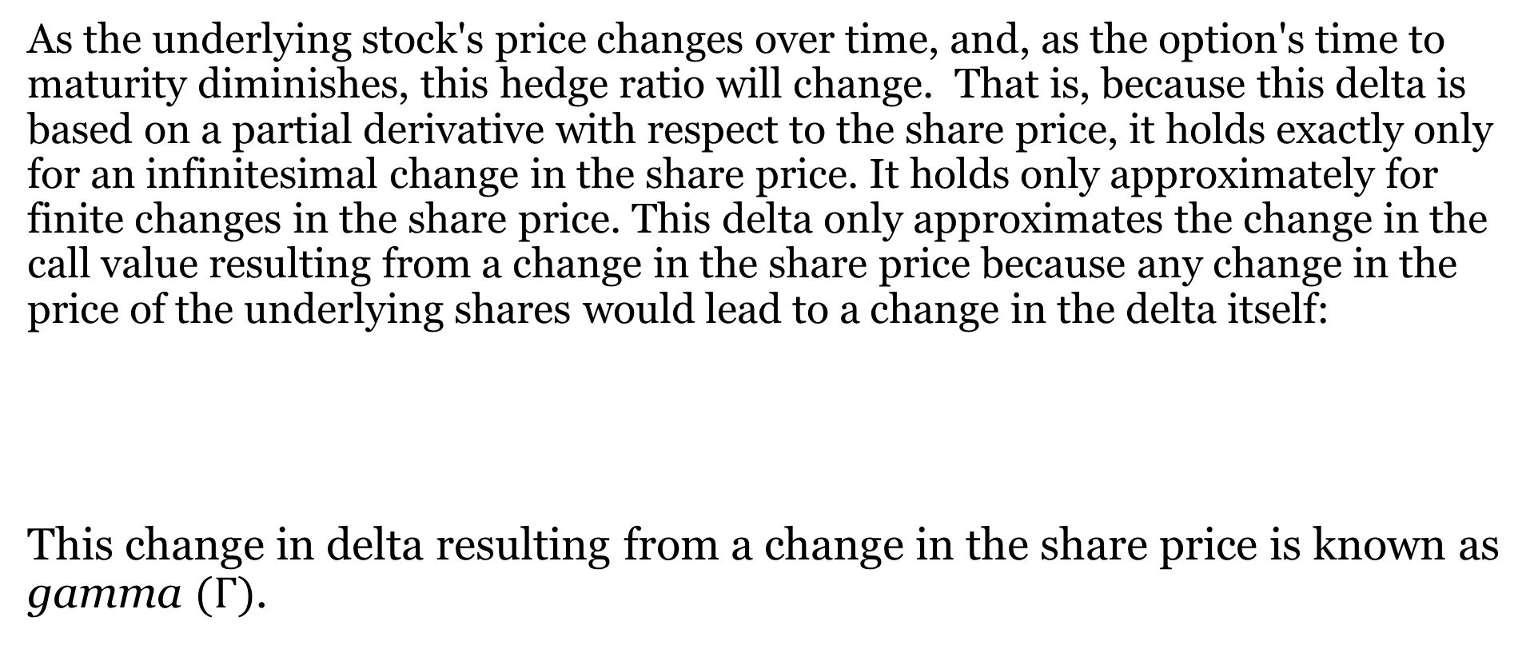
Gamma
As the underlying stock's price changes over time, and, as the option's time to maturity diminishes, this hedge ratio will change. That is, because this delta is based on a partial derivative with respect to the share price, it holds exactly only for an infinitesimal change in the share price. It holds only approximately for finite changes in the share price. This delta only approximates the change in the call value resulting from a change in the share price because any change in the price of the underlying shares would lead to a change in the delta itself:
This change in delta resulting from a change in the share price is known as gamma $(Γ)$.

Slide 5
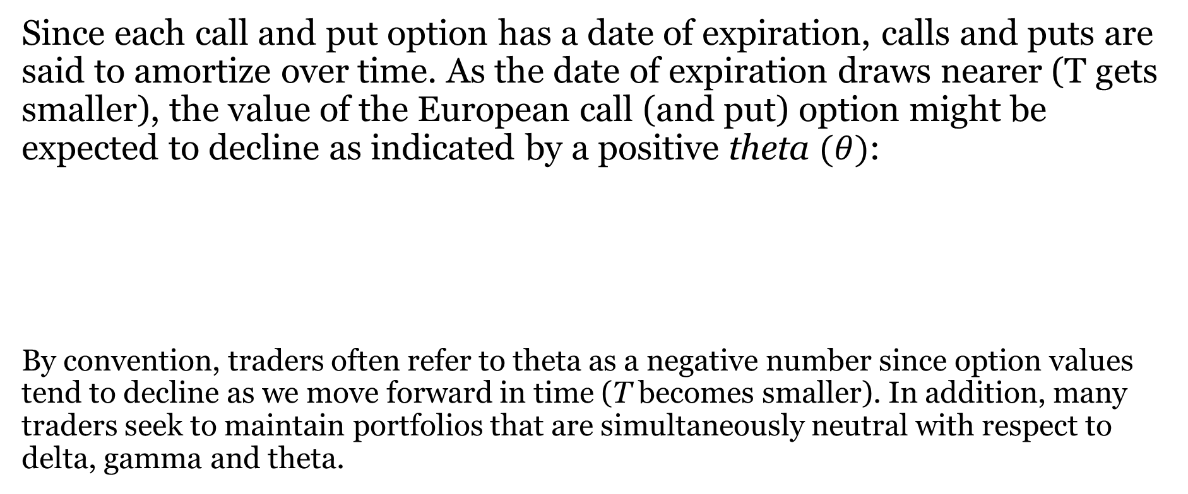
Theta
Since each call and put option has a date of expiration, calls and puts are said to amortize over time. As the date of expiration draws nearer (T gets smaller), the value of the European call (and put) option might be expected to decline as indicated by a positive theta $(θ)$:
By convention, traders often refer to theta as a negative number since option values tend to decline as we move forward in time (T becomes smaller). In addition, many traders seek to maintain portfolios that are simultaneously neutral with respect to delta, gamma and theta.

Slide 6
Vega
Vega (v), which actually is not a Greek letter, measures the sensitivity of the option price to the underlying stock's standard deviation of returns (vega is sometimes known as either kappa or zeta). As one would expect, the call option price is directly related to the underlying stock's standard deviation:

Slide 7
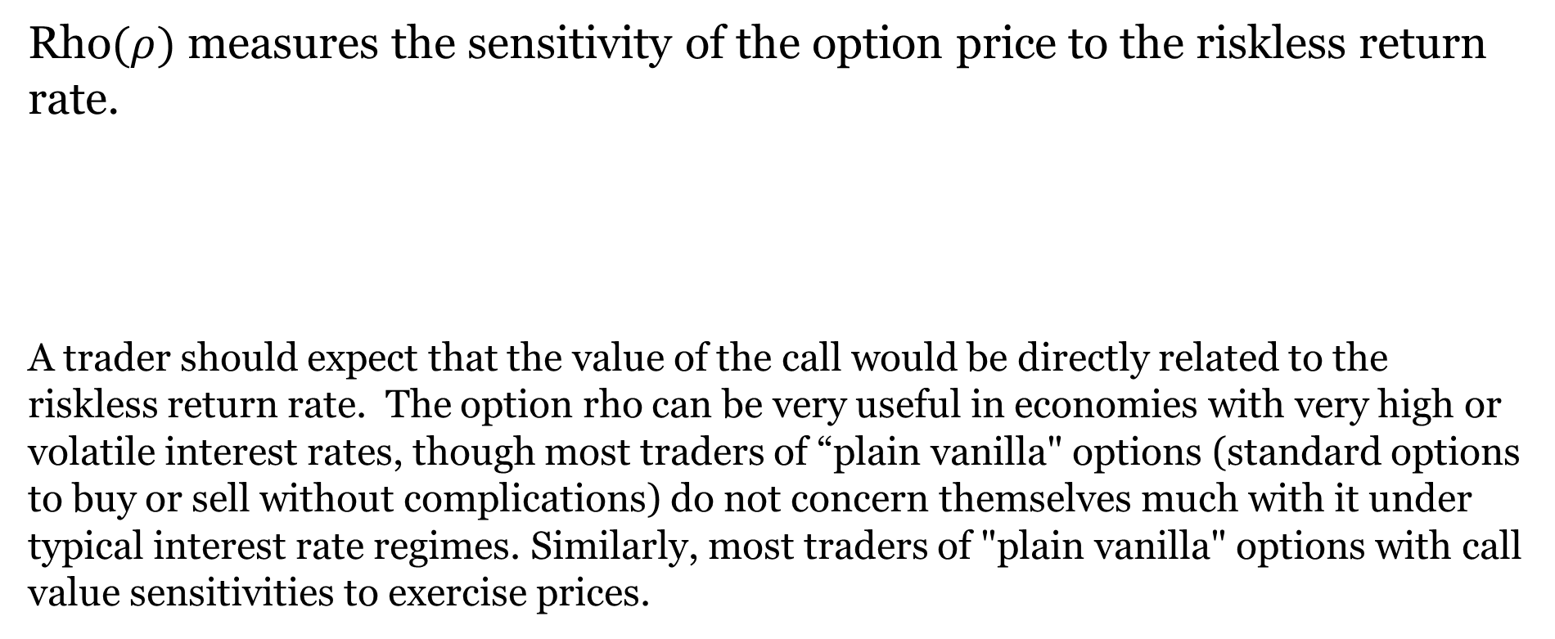
Rho
Rho$(ρ)$ measures the sensitivity of the option price to the riskless return rate.
A trader should expect that the value of the call would be directly related to the riskless return rate. The option rho can be very useful in economies with very high or volatile interest rates, though most traders of “plain vanilla" options (standard options to buy or sell without complications) do not concern themselves much with it under typical interest rate regimes. Similarly, most traders of "plain vanilla" options with call value sensitivities to exercise prices.

Slide 8
Illustration: Greeks Calculations For Calls
Here, we will calculate the Greeks for the call illustration from the previous section 7.4 with the following parameters:
T = .5 r = .10 σ = .41147 X = 80 S₀ = 75 c₀ = 8.20
Delta :
Gamma:

Slide 9
Illustration: Greeks Calculations For Calls (Continued)
Theta:
Vega :
Rho:
Note that traders sometimes change the sign for theta, actually using the derivative ∂c/∂t where T is replaced by (T-t) and t represents time as it approaches T. More generally, a single unit increase in the relevant parameter changes the Black-Scholes estimated call value by an amount approximately equal to the associated "Greek."

Slide 10
Illustration: Greeks Calculations for Puts
If Put-Call Parity holds along with Black-Scholes assumptions given above, the Black-Scholes put value from our example in Section 7.5.1 is computed as follows:
Delta:
Gamma:

Slide 11
Illustration: Greeks Calculations For Puts (Continued)
Theta:
Vega:
Rho:

Slide 12

B. The Black-Scholes Model and Dividend Adjustments
Pre-1973 OTC options were dividend protected.
With a single dividend payment made at time tD, the Black-Scholes replicating and differential equations become:

Slide 13
The Black-Scholes Model And Dividend Adjustments
Lumpy Dividend Adjustments
Merton’s Continuous Leakage Formula

Slide 14
Lumpy Dividend Adjustments
The European Known Dividend Model
Modeling American Calls
Black's Pseudo-American Call Model
The Roll-Geske-Whaley Compound Option Formula

Slide 15
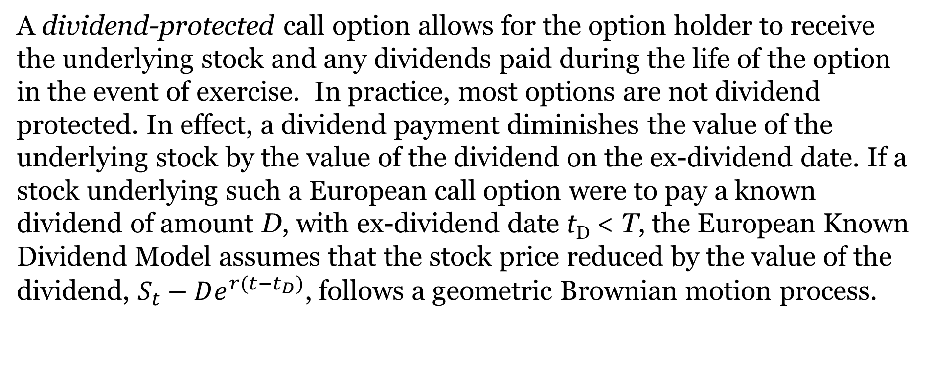
The European Known Dividend Model
A dividend-protected call option allows for the option holder to receive the underlying stock and any dividends paid during the life of the option in the event of exercise. In practice, most options are not dividend protected. In effect, a dividend payment diminishes the value of the underlying stock by the value of the dividend on the ex-dividend date. If a stock underlying such a European call option were to pay a known dividend of amount D, with ex-dividend date t_{D} < T, the European Known Dividend Model assumes that the stock price reduced by the value of the dividend, $S_{t}−De^{r(t−t_{D})}$, follows a geometric Brownian motion process.

Slide 16

The European Known Dividend Model (Continued)
The boundary condition is $c_{T}=MAX\left(S_{T}−e^{r(t−t_{D})}−X,0\right).$
The European Known Dividend Model can be used to evaluate the option as follows:

Slide 17
Modeling American Calls
Exercising American Calls Early in the Absence of Dividends:
The investor can choose between two portfolios A and B:
  A has one call not exercised before expiry with PV = Xe^{-rT} retained from not exercising.
  B has one share of stock purchased with exercise money X.
The last two columns of this table give expiration date portfolio values
Since the sum value of the call and exercise money is always either equal to or greater than the value of the stock on the expiration date (V_{AT} ≥ V_{BT}), the call should never be exercised early.

Slide 18
Modeling American Calls (Continued)
Exercising American Calls Early in the Presence of Dividends:
Premature exercise of an American call might occur when its underlying stock pays a dividend at t_{D} ≤ T.
This premature exercise will occur only on the ex-dividend date, and only when the dividend amount is higher than some critical ex-dividend date stock price S_{tD}*.

Slide 19
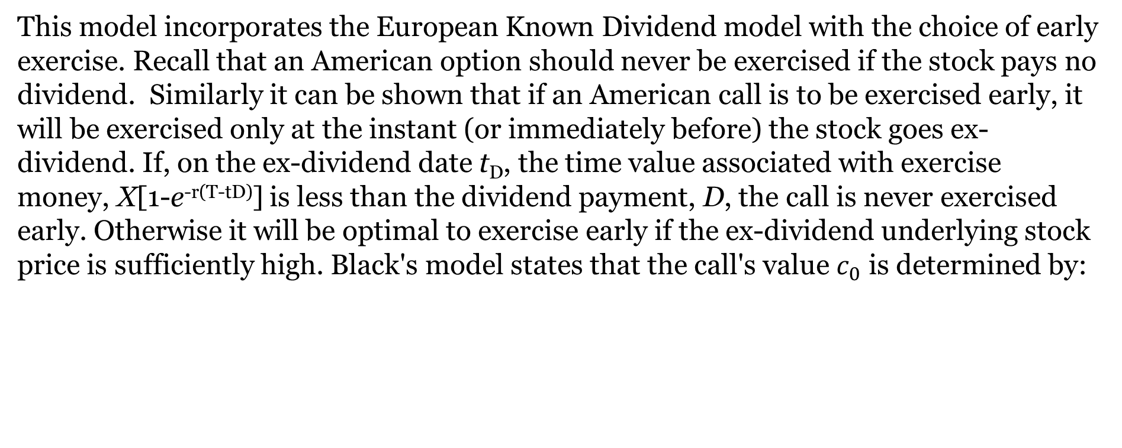
Black's Pseudo-American Call Model
This model incorporates the European Known Dividend model with the choice of early exercise. Recall that an American option should never be exercised if the stock pays no dividend. Similarly it can be shown that if an American call is to be exercised early, it will be exercised only at the instant (or immediately before) the stock goes ex-dividend. If, on the ex-dividend date t_{D}, the time value associated with exercise money, X[1-e^{-r(T-tD)}] is less than the dividend payment, D, the call is never exercised early. Otherwise it will be optimal to exercise early if the ex-dividend underlying stock price is sufficiently high. Black's model states that the call's value $c_{0}$ is determined by:
where $c_{0}^{∗}$ is the call's value assuming it is exercised immediately before the stock’s ex-dividend date and $c_{0}^{∗∗}$ is the call's value assuming the option is held until it expires.

Slide 20
The Roll-Geske-Whaley Compound Option Formula
The Roll-Geske-Whaley model requires that we first we find that minimum stock price (S_{tD}*) at the ex-dividend date (t_{D}) that will lead to early exercise of the option. That is, on the ex-dividend date, given a known dividend payment D, there is some minimum time t_{D} stock price S_{tD}* at which early exercise (on the ex-dividend date) is optimal. At this minimum price, or at a higher price, paying the exercise price and receiving the stock along with the dividend is worth more than retaining the call. Thus, it makes sense to exercise the call. All values of S_{tD} exceeding this price S_{tD}* will lead to early option exercise. This minimum price is found by solving the following for S_{tD}*:

Slide 21
The Roll-Geske-Whaley Compound Option Formula (Continued)
When dividends are zero, the call will never be exercised early. If dividends are small, the underlying stock price S_{tD}* at time t_{D} will need to be very large to justify early exercise of the call. Thus, for any dividend amount D > 0, there is some minimum stock price S_{tD}* on the ex-dividend date that would lead to early exercise of the American call.
M$\left(d(∗), y(∗); \sqrt{\frac{t_{D}}{T}}\right)$ is a cumulative multivariate (bivariate) normal distribution, where $\sqrt{\frac{t_{D}}{T}}$ is the correlation coefficient between random variables S_{tD} and S_{T}, assuming that stock returns are independent over non-overlapping periods of time.

Slide 22
The Roll-Geske-Whaley Compound Option Formula (Continued)

Slide 23
Illustration: Calculating the Value of an American Call on Dividend-Paying Stock
Suppose that we wish to calculate the value of a 6-month X = $45 American call on a share of stock that is currently selling for $50. The stock is expected to go ex-dividend on a $5 payment in three months, and not again until after the option expires. The standard deviation of returns on the underlying stock is .4 and the riskless return rate is 3%. What is the call worth today assuming:
The European Known Dividend model?
Black’s Pseudo-American Call model?
the Roll-Geske-Whaley model?

Slide 24
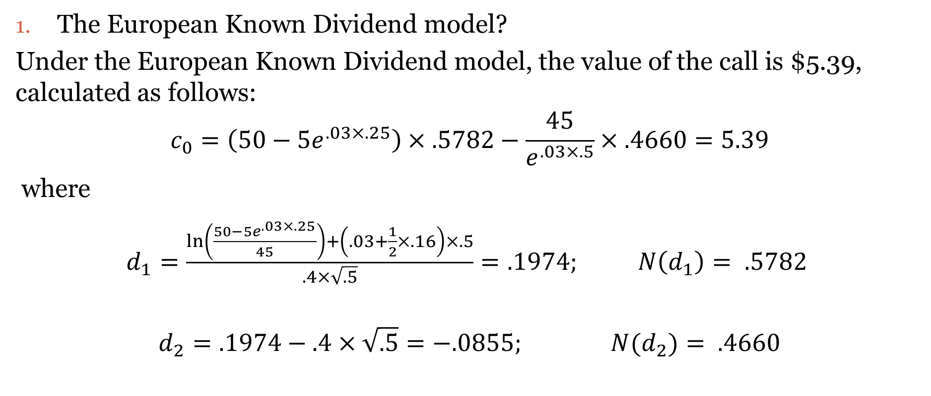
Illustration: Calculating the Value of a Call On Dividend-Paying Stock (Known European Dividend Model)
The European Known Dividend model?
Under the European Known Dividend model, the value of the call is $5.39, calculated as follows:
$$c_{0}=\left(50−5e^{.03×.25}\right)×.5782−\frac{45}{e^{.03×.5}}×.4660=5.39$$
where
$d_{1}=\frac{\ln\left(\frac{50−5e^{.03×.25}}{45}\right)+\left(.03+\frac{1}{2}×.16\right)×.5}{.4×\sqrt{.5}}=.1974; N\left(d_{1}\right)= .5782$
$$d_{2}=.1974−.4×\sqrt{.5}{=−.0855; N(d}_{2})= .4660$$

Slide 25
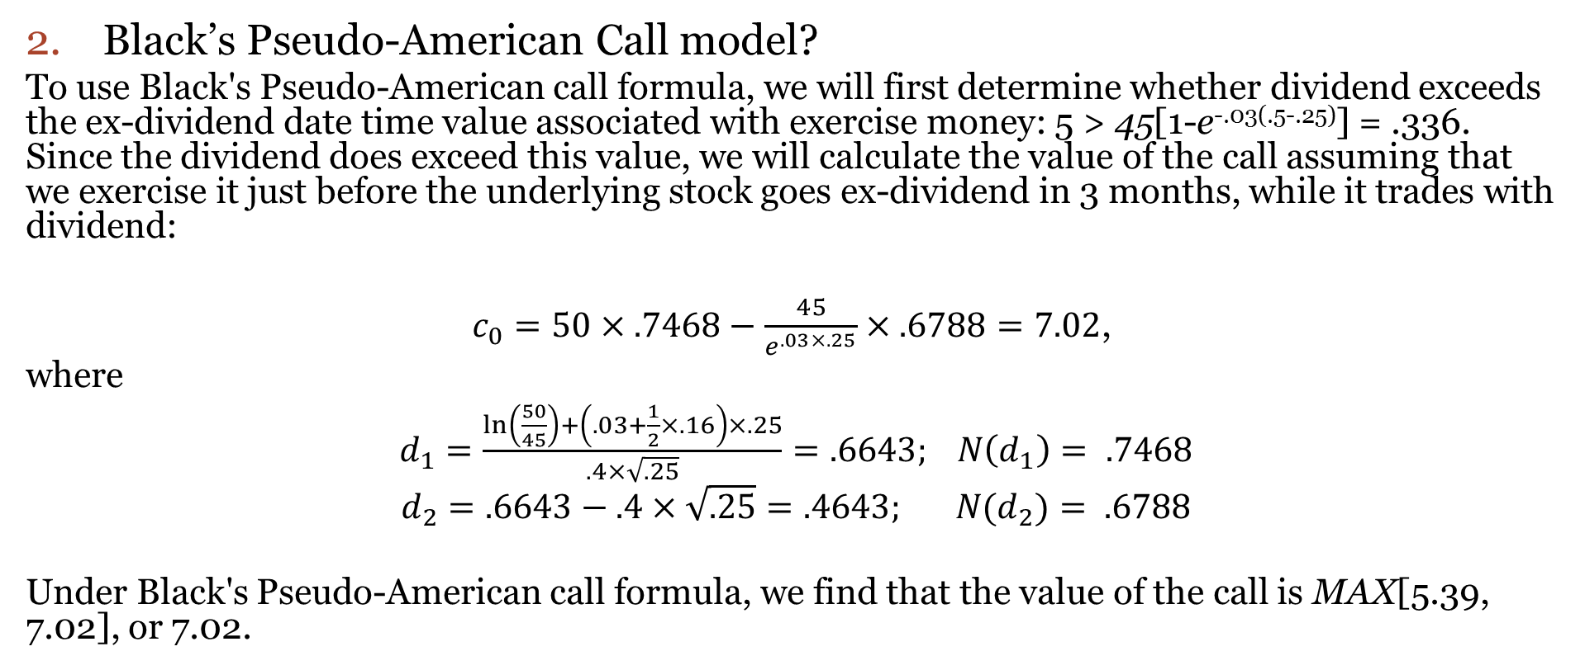
Illustration: Calculating the Value of an American Call on Dividend-Paying Stock (Black’s Pseudo-American Call Model)
2. Black’s Pseudo-American Call model?
To use Black's Pseudo-American call formula, we will first determine whether dividend exceeds the ex-dividend date time value associated with exercise money: 5 > 45[1-e^{-.03(.5-.25)}] = .336. Since the dividend does exceed this value, we will calculate the value of the call assuming that we exercise it just before the underlying stock goes ex-dividend in 3 months, while it trades with dividend:
$c_{0}=50×.7468−\frac{45}{e^{.03×.25}}×.6788=7.02$,
where
$d_{1}=\frac{\ln\left(\frac{50}{45}\right)+\left(.03+\frac{1}{2}×.16\right)×.25}{.4×\sqrt{.25}}=.6643; N\left(d_{1}\right)= .7468$
$d_{2}=.6643−.4×\sqrt{.25}{=.4643; N(d}_{2})= .6788$
Under Black's Pseudo-American call formula, we find that the value of the call is MAX[5.39, 7.02], or 7.02.

Slide 26
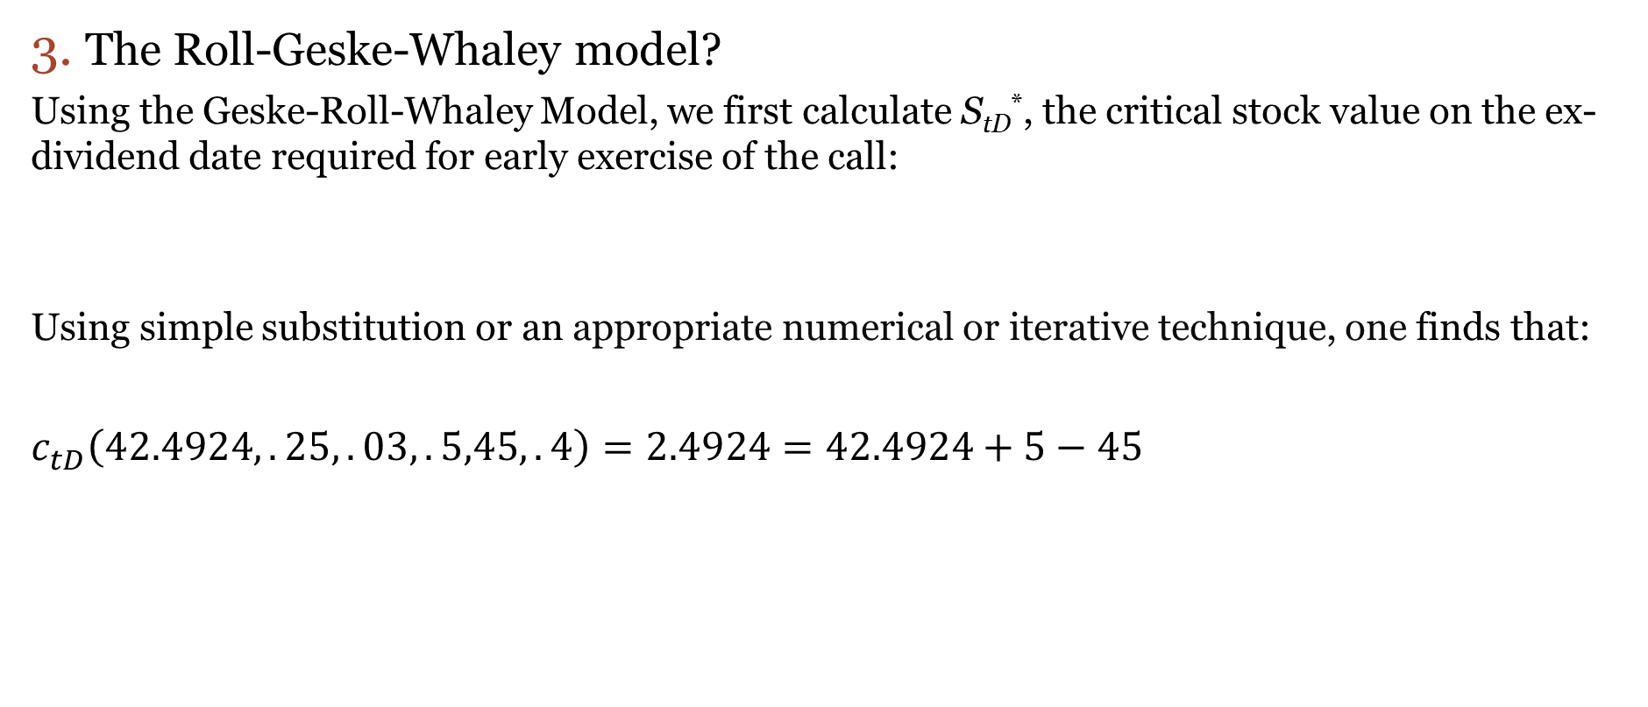
Illustration: Calculating the Value Of An American Call On Dividend-Paying Stock (Continued)
3. The Roll-Geske-Whaley model?
Using the Geske-Roll-Whaley Model, we first calculate S_{tD}*, the critical stock value on the ex-dividend date required for early exercise of the call:
Using simple substitution or an appropriate numerical or iterative technique, one finds that:
$c_{tD}^{ }\left(42.4924,.25,.03,.5,45,.4\right)=2.4924=42.4924+5−45$
$$c_{tD}^{ }(S_{tD}^{∗},.25,.03,.5,45,.4)=S_{tD}^{∗}+5−45$$
This means that if the stock is selling for S_{tD}* = $42.4924 in 3 months (t_{D} = .25), the call on the stock trading ex-dividend will have the same value as the stock, plus declared dividend minus the exercise money. Thus, as long as the ex-dividend value of the stock plus the dividend minus exercise money exceeds the ex-dividend call value, the call will be exercised early.

Slide 27
Illustration: Calculating the Value Of An American Call On Dividend-Paying Stock (Continued)
3. The Roll-Geske-Whaley model? (continued)
The value of the American call is found to be 6.96, as follows:
Where

Slide 28

C. Merton’s Continuous Leakage Formula
Many options on indices (index options) and on funds trade on portfolios holding many stocks in which dividends are scattered over time.
It is often convenient to work with dividend leakage from such portfolios, assuming dividend rates rather than lumpy dividends.
The B-S differential equation for the continuous leakage model is:

Slide 29
Merton’s Continuous Leakage Formula (Continued)
Its particular solution, subject to the boundary condition c_{T} = MAX[0, S_{T} - X] for a European call, is given as follows:
where
and for a European put:
p₀ = c₀ + Xe^{-rT} - S₀e^{-δT}

Slide 30
Illustration: Continuous Dividend Leakage
A six-month options on a stock that is currently priced at $75. The exercise price of the call and put are $80 and the current riskless rate of return is 10% per annum. The variance of annual returns on the underlying stock is 16%. However, this stock will pay a continuous annual dividend at a rate of 2%. What are the values of these call and put options on this stock?
With N(d₁) = .522 and N(d₂) = .41
p₀ = 7.56 + 80(.9512) - 75e^{-.02×.5} = 9.41

