Slide 1
Chapter 12
Beyond Plain Vanilla Options on Stock

Slide 2
A. Compound Options
A compound option is simply an option on an option.
A compound option has two (or more) exercise prices and two (or more) expiration dates:
  (X₁, T₁) that applies to the right to buy or sell the underlying option
  (X₂, T₂) that applies to buying or selling the underlying security with T₁ < T₂.
Denote the values of the underlying call and put at time t by c_{u,t} and p_{u,t},.
Assume that there is a European option on this underlying option with exercise price X₁ on expiration date T₁.

Slide 3
Compound Option Varieties
Compound options come in 4 varieties with the following exercise date T₁ payoff functions, where c_{u,T1} and p_{u,T1} are exercise date underlying call and put values:
Call on call: MAX[c_{u,T1} -X₁, 0]
Put on call: MAX[X₁ - c_{u,T1}, 0]
Call on put: MAX[p_{u,T1} -X₁, 0]
Put on put: MAX[X₁ - p_{u,T1}, 0]
Values of the underlying call and put at time t by c_{u,t} and p_{u,t}

Slide 4
Compound Call
A call on a call gives its owner the right to purchase an underlying call with value c_{u,T1} at time T₁ for price X₁.
The compound call is exercised at time T₁ only if the underlying call at time T₁ is sufficiently valuable.
is the critical value for the “underlying-underlying” stock at which the underlying call value c_{u,T1} will exceed the exercise price X₁ of the compound call.
The underlying option is a European option with exercise price X₂ and expiration date T₂.

Slide 5
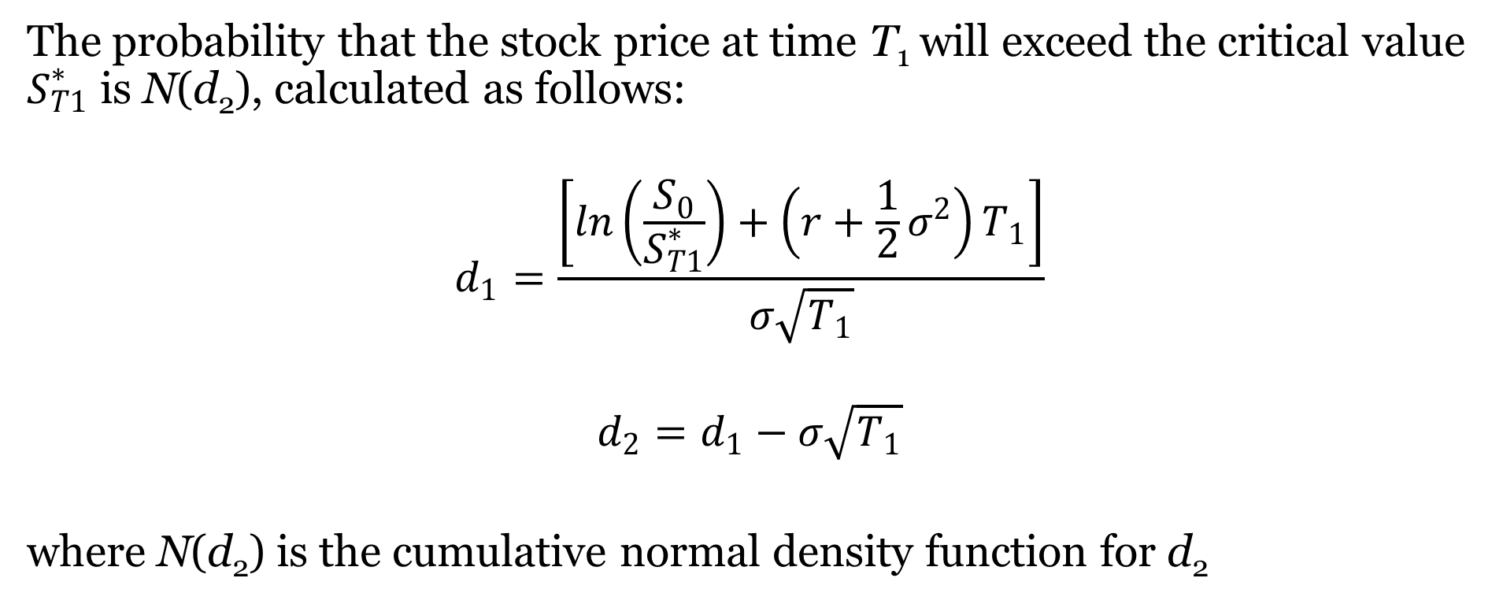
Estimating Call Exercise Probabilities
The probability that the stock price at time T₁ will exceed the critical value $S_{T1}^{∗}$ is N(d₂), calculated as follows:
$$d_{1}=\frac{\left[ln\left(\frac{S_{0}}{S_{T1}^{∗}}\right)+\left(r+\frac{1}{2}σ^{2}\right)T_{1}\right]}{σ\sqrt{T_{1}}}$$
$$d_{2}=d_{1}−σ\sqrt{T_{1}}$$
where N(d₂) is the cumulative normal density function for d₂

Slide 6
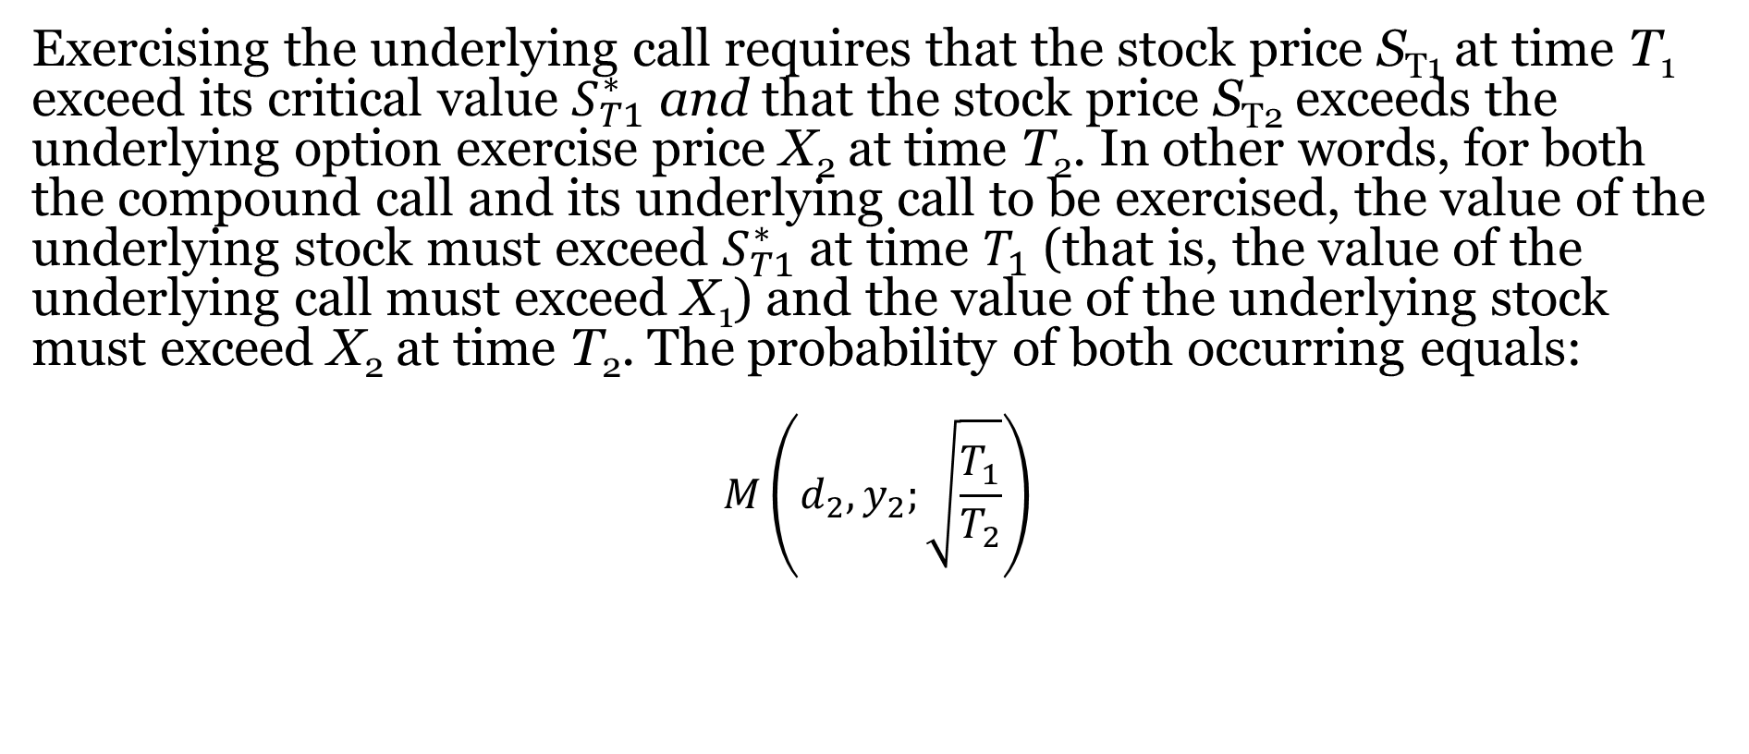
Estimating Underlying Call Exercise Probabilities
Exercising the underlying call requires that the stock price S_{T1} at time T₁ exceed its critical value $S_{T1}^{∗}$ and that the stock price S_{T2} exceeds the underlying option exercise price X₂ at time T₂. In other words, for both the compound call and its underlying call to be exercised, the value of the underlying stock must exceed $S_{T1}^{∗}$ at time $T_{1}$ (that is, the value of the underlying call must exceed X₁) and the value of the underlying stock must exceed X₂ at time T₂. The probability of both occurring equals:
$$M\left(d_{2},y_{2};\sqrt{\frac{T_{1}}{T_{2}}}\right)$$

Slide 7
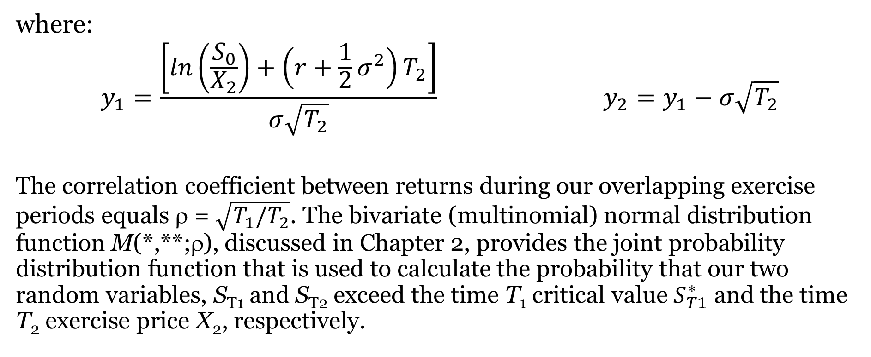
Estimating Underlying Call Exercise Probabilities (Continued)
where:
$$y_{1}=\frac{\left[ln\left(\frac{S_{0}}{X_{2}}\right)+\left(r+\frac{1}{2}σ^{2}\right)T_{2}\right]}{σ\sqrt{T_{2}}} y_{2}=y_{1}−σ\sqrt{T_{2}}$$
The correlation coefficient between returns during our overlapping exercise periods equals ρ = $\sqrt{T_{1}/T_{2}}$. The bivariate (multinomial) normal distribution function M(*,**;ρ), discussed in Chapter 2, provides the joint probability distribution function that is used to calculate the probability that our two random variables, S_{T1} and S_{T2} exceed the time T₁ critical value $S_{T1}^{∗}$ and the time T₂ exercise price X₂, respectively.

Slide 8
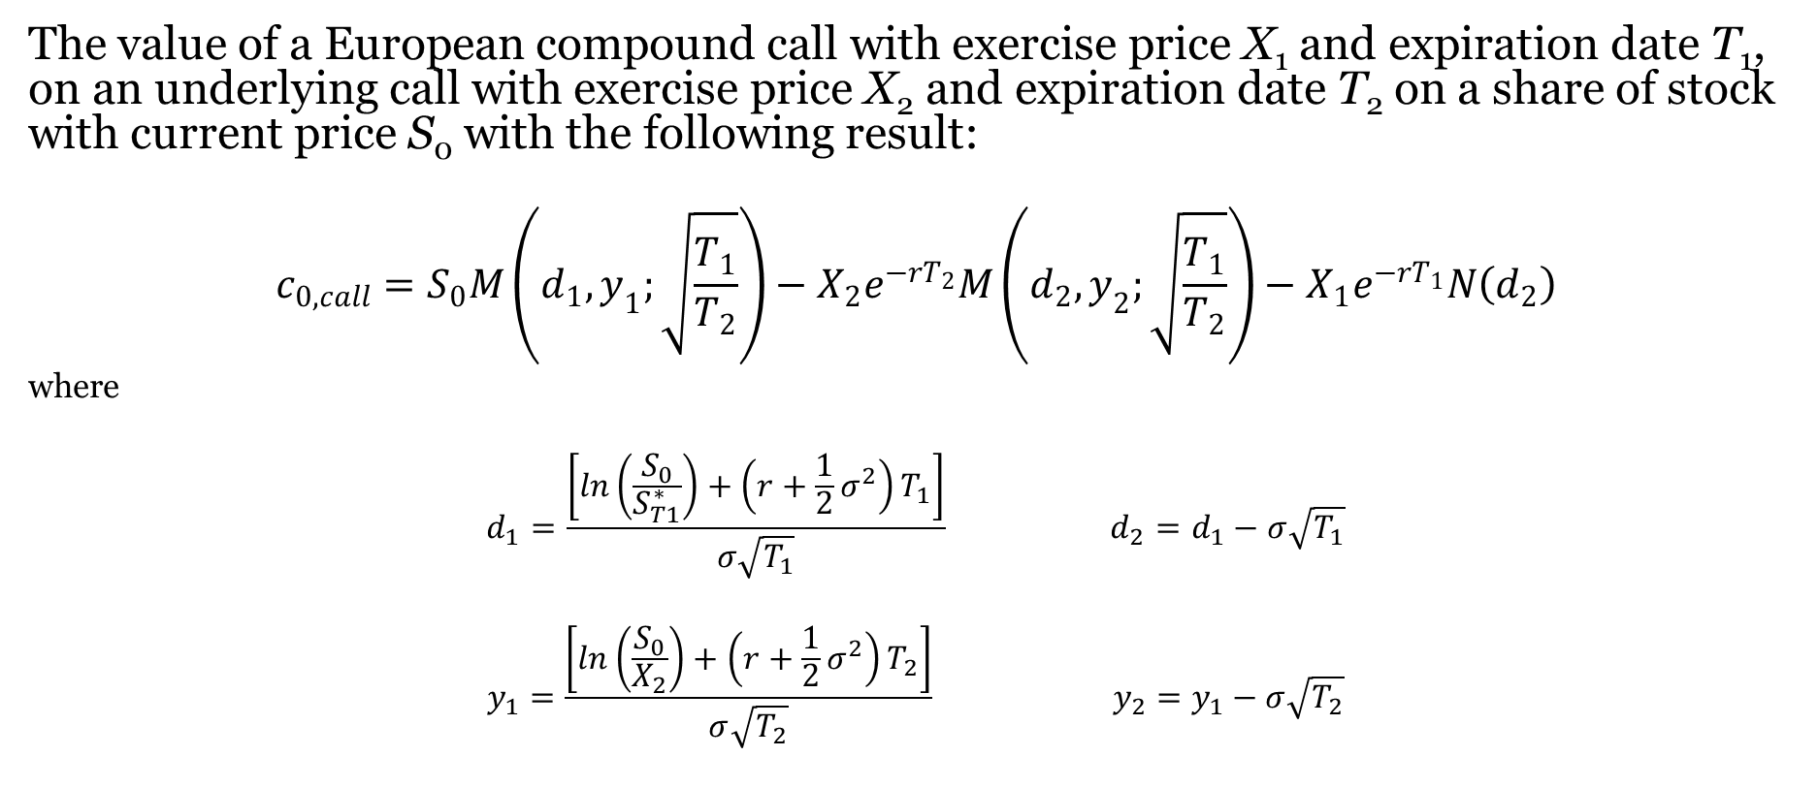
Valuing The Compound Call
The value of a European compound call with exercise price X₁ and expiration date T₁, on an underlying call with exercise price X₂ and expiration date T₂ on a share of stock with current price S₀ with the following result:
$$c_{0,call}=S_{0}M\left(d_{1},y_{1};\sqrt{\frac{T_{1}}{T_{2}}}\right)−X_{2}e^{−rT_{2}}M\left(d_{2},y_{2};\sqrt{\frac{T_{1}}{T_{2}}}\right)−X_{1}e^{−rT_{1}}N\left(d_{2}\right)$$
where
$$d_{1}=\frac{\left[ln\left(\frac{S_{0}}{S_{T1}^{∗}}\right)+\left(r+\frac{1}{2}σ^{2}\right)T_{1}\right]}{σ\sqrt{T_{1}}} d_{2}=d_{1}−σ\sqrt{T_{1}}$$
$$y_{1}=\frac{\left[ln\left(\frac{S_{0}}{X_{2}}\right)+\left(r+\frac{1}{2}σ^{2}\right)T_{2}\right]}{σ\sqrt{T_{2}}} y_{2}=y_{1}−σ\sqrt{T_{2}}$$

Slide 9
Illustration: Valuing The Compound Call
Consider a compound call with exercise price X₁ = 3, expiring in three months (T₁ = .25) on an equity call, with exercise price X₂ = 45, expiring in 6 months (T₂ = .5). The stock currently sells for S₀ = 50 and has a return volatility equal to 𝜎 = .4. Thus, the compound call gives its owner the right to buy an underlying call in three months for $3, which will confer the right to buy the underlying stock in six months for $45. The riskless return rate equals r = .03. What is the value of this compound call?

Slide 10
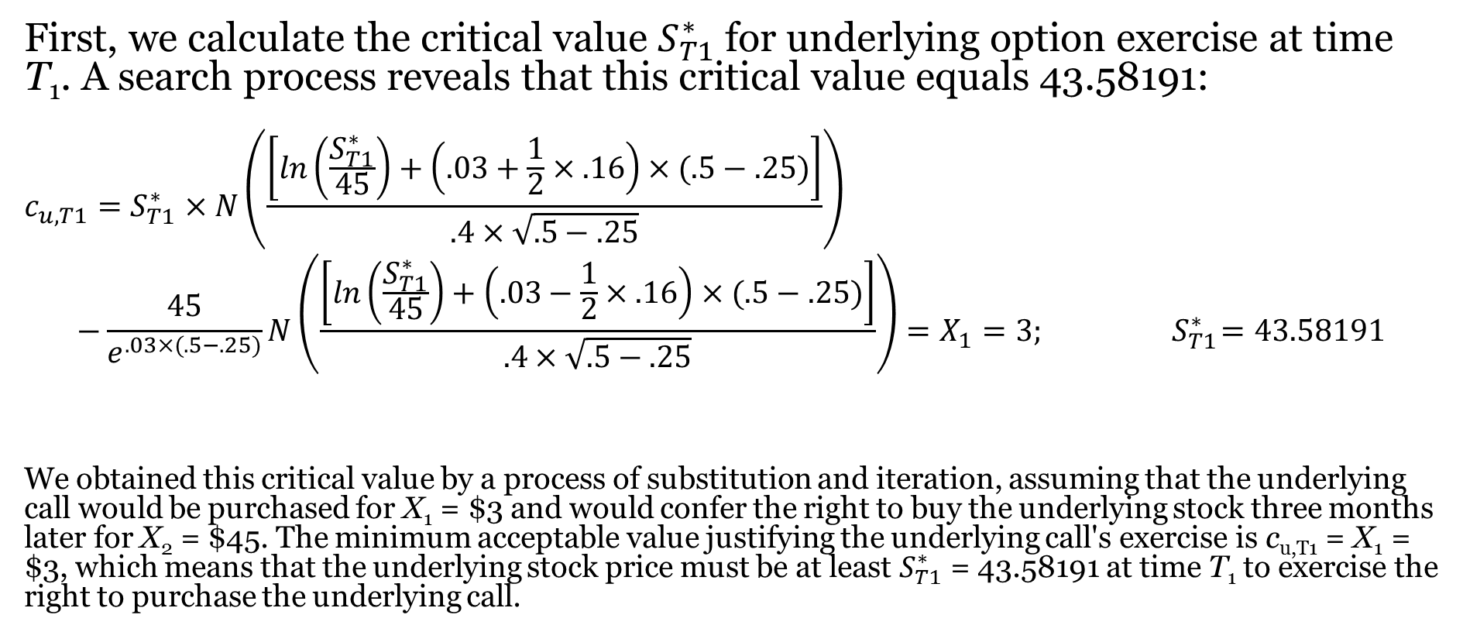
Illustration: Valuing the Compound Call (Continued)
First, we calculate the critical value $S_{T1}^{∗}$ for underlying option exercise at time T₁. A search process reveals that this critical value equals 43.58191:
$$c_{u,T1}=S_{T1}^{∗}×N\left(\frac{\left[ln\left(\frac{S_{T1}^{∗}}{45}\right)+\left(.03+\frac{1}{2}×.16\right)×(.5−.25)\right]}{.4×\sqrt{.5−.25}}\right)$$
$$−\frac{45}{e^{.03×(.5−.25)}}N\left(\frac{\left[ln\left(\frac{S_{T1}^{∗}}{45}\right)+\left(.03−\frac{1}{2}×.16\right)×(.5−.25)\right]}{.4×\sqrt{.5−.25}}\right)=X_{1}=3; { S}_{T1}^{∗}=43.58191$$
We obtained this critical value by a process of substitution and iteration, assuming that the underlying call would be purchased for X₁ = $3 and would confer the right to buy the underlying stock three months later for X₂ = $45. The minimum acceptable value justifying the underlying call's exercise is c_{u,T1} = X₁ = $3, which means that the underlying stock price must be at least $S_{T1}^{∗}$ = 43.58191 at time T₁ to exercise the right to purchase the underlying call.

Slide 11
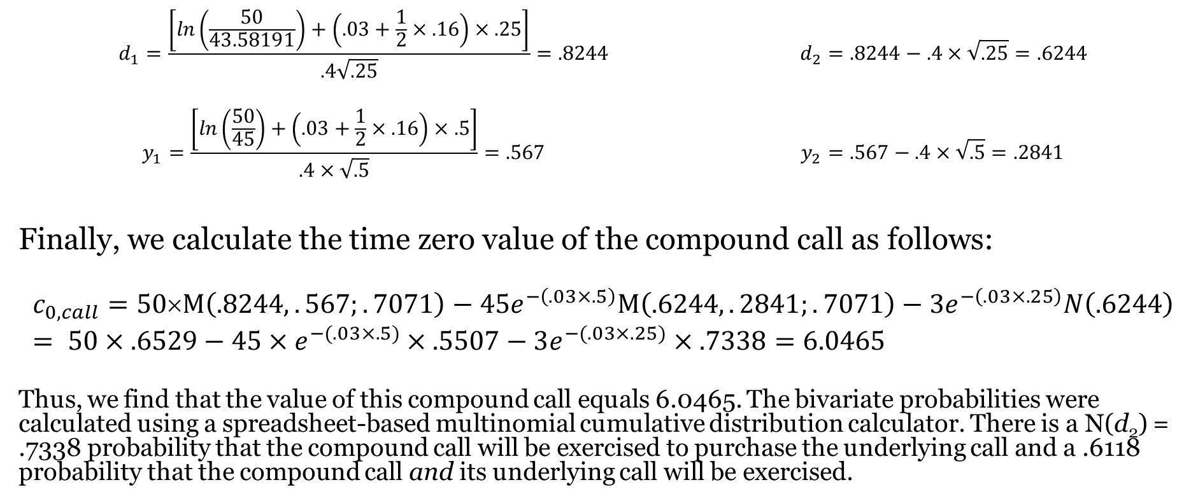
Illustration: Valuing the Compound Call (Continued)
$$d_{1}=\frac{\left[ln\left(\frac{50}{43.58191}\right)+\left(.03+\frac{1}{2}×.16\right)×.25\right]}{.4\sqrt{.25}}=.8244 d_{2}=.8244−.4×\sqrt{.25}=.6244$$
$$y_{1}=\frac{\left[ln\left(\frac{50}{45}\right)+\left(.03+\frac{1}{2}×.16\right)×.5\right]}{.4×\sqrt{.5}}=.567 y_{2}=.567−.4×\sqrt{.5}=.2841$$
Finally, we calculate the time zero value of the compound call as follows:
$$c_{0,call}=50×M\left(.8244,.567;.7071\right)−45e^{−\left(.03×.5\right)}M\left(.6244,.2841;.7071\right)−3e^{−\left(.03×.25\right)}N\left(.6244\right)= 50×.6529−45×e^{−(.03×.5)}×.5507−3e^{−(.03×.25)}×.7338=6.0465$$
Thus, we find that the value of this compound call equals 6.0465. The bivariate probabilities were calculated using a spreadsheet-based multinomial cumulative distribution calculator. There is a N(d₂) = .7338 probability that the compound call will be exercised to purchase the underlying call and a .6118 probability that the compound call and its underlying call will be exercised.

Slide 12
Illustration 2: Calculating the Value Of An American Call On Dividend-Paying Stock
The Roll-Geske-Whaley model: The value of an American call is found to be 6.96, as follows:
Where

Slide 13
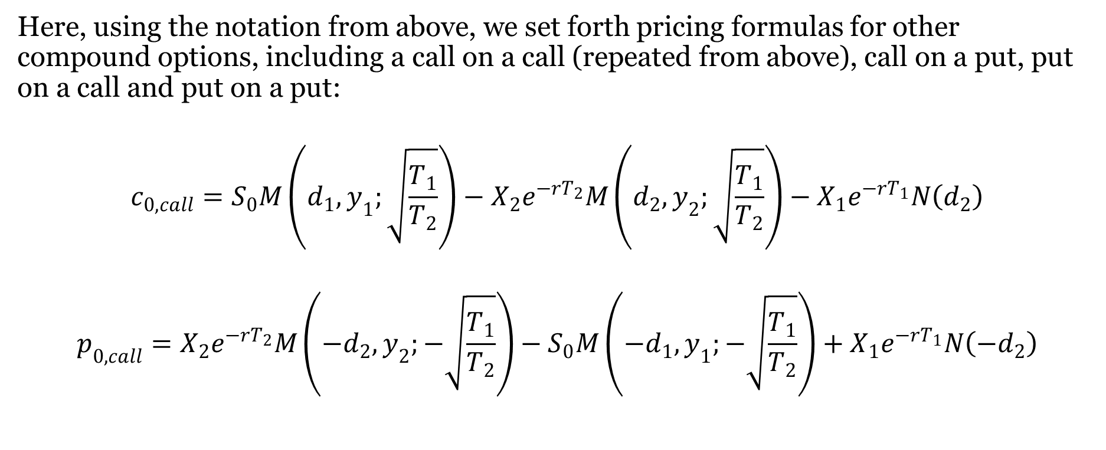
Put-Call Parity For Compound Options
Here, using the notation from above, we set forth pricing formulas for other compound options, including a call on a call (repeated from above), call on a put, put on a call and put on a put:
$$c_{0,call}=S_{0}M\left(d_{1},y_{1};\sqrt{\frac{T_{1}}{T_{2}}}\right)−X_{2}e^{−rT_{2}}M\left(d_{2},y_{2};\sqrt{\frac{T_{1}}{T_{2}}}\right)−X_{1}e^{−rT_{1}}N\left(d_{2}\right)$$
$$p_{0,call}=X_{2}e^{−rT_{2}}M\left({−d}_{2},y_{2};−\sqrt{\frac{T_{1}}{T_{2}}}\right)−S_{0}M\left(−d_{1},y_{1};−\sqrt{\frac{T_{1}}{T_{2}}}\right)+X_{1}e^{−rT_{1}}N\left({−d}_{2}\right)$$

Slide 14
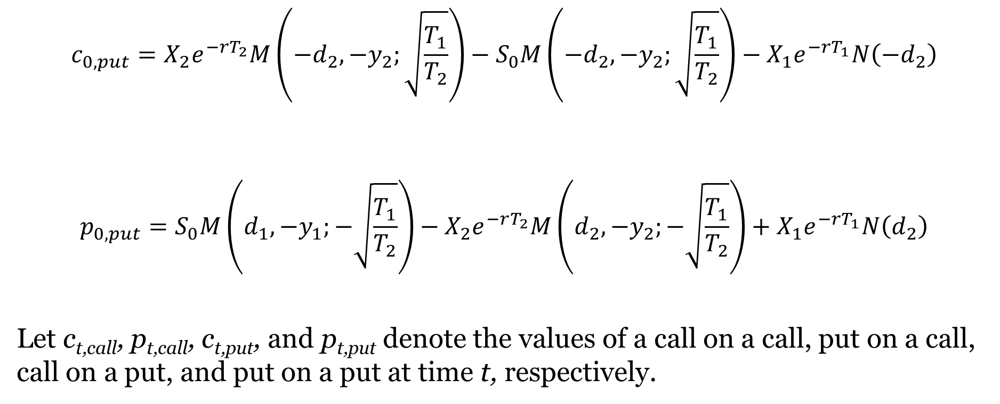
Put-Call Parity For Compound Options (Continued)
$$c_{0,put}=X_{2}e^{−rT_{2}}M\left({−d}_{2},{−y}_{2};\sqrt{\frac{T_{1}}{T_{2}}}\right)−S_{0}M\left(−d_{2},{−y}_{2};\sqrt{\frac{T_{1}}{T_{2}}}\right)−X_{1}e^{−rT_{1}}N\left({−d}_{2}\right)$$
$$p_{0,put}=S_{0}M\left(d_{1},{−y}_{1};−\sqrt{\frac{T_{1}}{T_{2}}}\right)−X_{2}e^{−rT_{2}}M\left(d_{2},{−y}_{2};−\sqrt{\frac{T_{1}}{T_{2}}}\right)+X_{1}e^{−rT_{1}}N\left(d_{2}\right)$$
Let c_{t,call}, p_{t,call}, c_{t,put}, and p_{t,put} denote the values of a call on a call, put on a call, call on a put, and put on a put at time t, respectively.

Slide 15

Put-Call Parity For Compound Options (Continued)
Present Value:
$$c_{0,call}{ − p}_{0,call} {={ c}_{0,put} − p}_{0,put}+{ S}_{0}−X_{2}e^{−rT_{2}}$$
Time T₁ Value:
MAX[c_{u,T1} -X₁,0] - MAX[X₁ - c_{u,T1},0] = MAX[p_{u,T1} -X₁,0]-MAX[X₁ - p_{u,T1},0]$+ S_{0}−X_{2}e^{−rT_{2}}$
c_{u,T1} -X₁ = p_{u,T1} -X₁ $+ S_{0}−X_{2}e^{−rT_{2}}$
Where c_{t,call}, p_{t,call}, c_{t,put}, and p_{t,put} denote the values of a call on a call, put on a call, call on a put, and put on a put at time t, respectively.

Slide 16

B. Changing the Pricing Numeraire
Suppose you were interested in evaluating an option to exchange one commodity or instrument for another.
Exchange options can be evaluated by simply changing the Numeraire:

Slide 17
Black-Scholes for the Exchange Call
the value of a single exchange call (c₀) as follows:

Slide 18
Beyond Plain Vanilla Options On Stock
Exchange Options: Provide for the exchange of one asset for another
Currency Options: A specific type of exchange option that provides for the exchange of one currency for another

Slide 19


C. Exchange Options
An obvious and important application for the application of the numeraire change is to the valuation of exchange (currency, FX) options.
Suppose that two currencies prices follow geometric Brownian motion processes as follows:

Slide 20
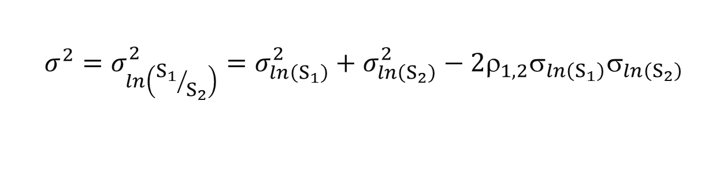

Exchange Options
Suppose that the prices S₁ and S₂ of two assets follow geometric Brownian motion processes with σ₁ and σ₂ as standard deviations of logarithms of price relatives (or returns) for each of the two securities:
And the variance of logarithms of price relatives of the two assets relative to one another is σ²:
where E[dZ₁ × dZ₂] = ρ_{1,2}dt, where ρ_{1,2} is the correlation coefficient between logarithms of price relatives ln(S₁/S₂) between the two securities.
$$\frac{{dS}_{1}}{S_{1}}= μ_{1}dt+σ_{1}{dZ}_{1} \frac{{dS}_{2}}{S_{2}}= μ_{2}dt+σ_{2}{dZ}_{2}$$
$$σ^{2}=σ_{\ln\left({S_{1}}/{S_{2}}\right)}^{2}=σ_{\ln\left(S_{1}\right)}^{2}+σ_{\ln\left(S_{2}\right)}^{2}−2ρ_{1,2}σ_{\ln\left(S_{1}\right)}σ_{\ln\left(S_{2}\right)}$$

Slide 21
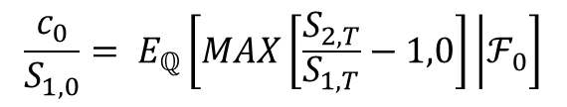
Changing The Numeraire For Pricing The Exchange Call
Using our notation from Section 7.2.3, the exchange option is valued in risk-neutral probability space as:
We can change our numeraire to stock 1. Now, the exchange option can be valued in a Black-Scholes environment with stock 1 as the numeraire:
where
$$\frac{c_{0}}{S_{1,0}}= E_{ℚ}\left[MAX\left[\frac{S_{2,T}}{S_{1,T}}−1,0\right] | ℱ_{0}\right]$$

Slide 22
Currency Options
Interest rates may differ between the foreign and domestic countries.
We quote two interest rates r(f) and r(d), one each for the foreign and domestic currencies.
The standard differential equation for currency options is as follows:
where s is the exchange rate, r(d) is the domestic riskless rate (the rate for the currency that will be given up if the option is exercised), r(f) is the foreign riskless rate (the rate for the currency which may be purchased).

Slide 23
Currency Options (Continued)
The solution the exchange option differential equation, subject to the boundary condition is given as follows:
where

Slide 24
The Garman- Köhlagen Model
In other words, we have the The Garman- Köhlagen Model for pricing currency options:

Slide 25
Exchange Option Illustration
The Predator Company has announced its intent to acquire the Prey Company through an exchange offer.
This offer expires in 90 days (T = .25 years).
Shares of stock in the two companies follow geometric Brownian motion processes with a variance of σ²_{ln(S1)} = .16 for Predator (Predator is company 1) and σ²_{ln(S2)} = .36 for Prey, and zero correlation ρ_{1,2} = 0 between the two.
Predator Company stock is currently selling for $40 and Prey shares are selling for $50.
The current riskless return rate is .05.
What is the value of the exchange option associated with this tender offer?

Slide 26
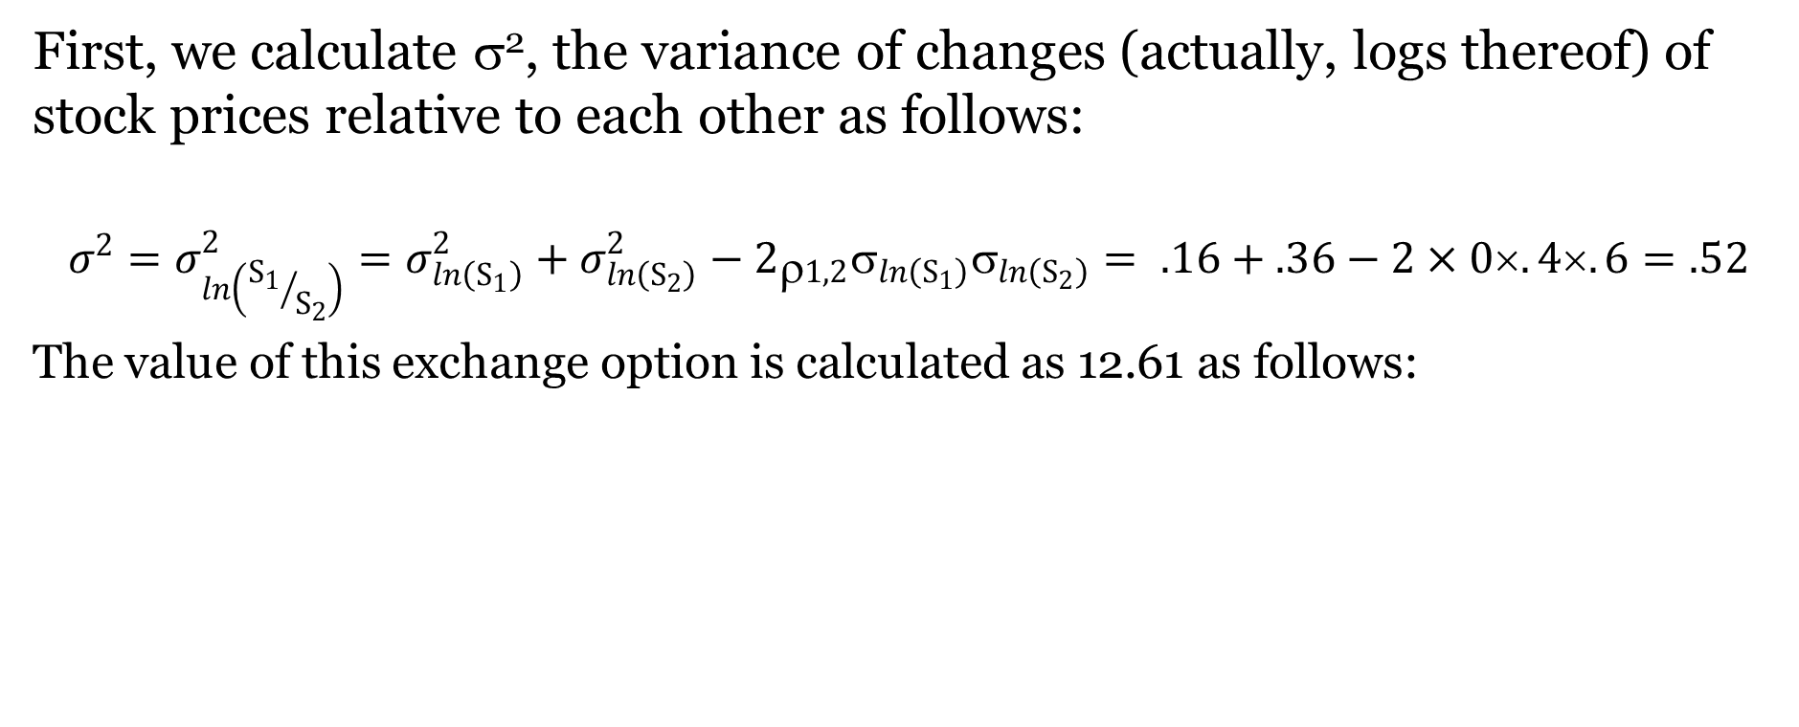
Exchange Option Illustration (Continued)
First, we calculate σ², the variance of changes (actually, logs thereof) of stock prices relative to each other as follows:
$$σ^{2}=σ_{\ln\left({S_{1}}/{S_{2}}\right)}^{2}=σ_{\ln\left(S_{1}\right)}^{2}+σ_{\ln\left(S_{2}\right)}^{2}−2_{ρ1,2}σ_{\ln\left(S_{1}\right)}σ_{\ln\left(S_{2}\right)}= .16+.36−2×0×.4×.6=.52$$
The value of this exchange option is calculated as 12.61 as follows:

Slide 27
Currency Option Illustration
Consider the following example where call options are traded on Brazilian real (BRL). One U.S. dollar is currently worth 2 Brazilian real (s₀ = .5). We wish to evaluate a 2-year European call and put on BRL with exercise prices equal to X = .45. U.S. and Brazilian interest rates are .03 and .08, respectively. The annual standard deviation of exchange rates is .15.
We calculate d₁ = .1313 and d₂ = -.0808; N(d₁) and N(d₂) are .5522 and .4678, respectively. Thus the call is valued at c₀ = .037 and the put is valued at p₀ = .035.

Slide 28
Currency Option Valuation
Garman and Köhlagen [1983] and Grabbe [1983] currency option pricing model:

Slide 29
Currency Option Illustration
Consider the following example where call options are traded on Swiss francs (CHF).
One U.S. dollar is currently worth 1.8 Swiss francs (s₀ = .5556).
We wish to evaluate a 6-month European call and put on CHF with exercise prices equal to X = .5556.
U.S. and Swiss interest rates are both .10.
The annual standard deviation of exchange rates is .40.

Slide 30
Currency Option Illustration, Continued

Slide 31
D. Hedging Exchange Exposure with Currency Options
Suppose that the Dayton Company of America is considering hedging a payoff of £1,000,000 in 3 months, which it intends to convert to dollars. Further assume:
  Spot exchange rate: $1.7640/£
  Three month forward exchange rate: $1.7540/£
  U.K. Borrowing interest rate: 10.0%
  U.S. Borrowing interest rate: 8.0%
  U.K. Lending interest rate: 8.0%
  U.S. Lending interest rate: 6.0 %

Slide 32
Hedging with FX Derivatives
There are call and put options and forward contracts with the following terms:
  Term to options expiration: 3 months
  Exercise price: $1.75 per £
  Put Premium: $0.025 per £
  Call Premium: $.065 per £
  Brokerage cost per options contract on £31,250: $50

Slide 33
The Put Hedge Strategy
The company will purchase 3-month put options on £1,000,000 with an exercise price of $1.75/£ with a total premium of $25,000.
Time zero brokerage costs total $1,600 (32 contracts at $50 per contract).
The total time zero cash outlay is $26,600.
Forgone interest on the sum of the premium and brokerage costs totals $399.
Expressed in terms of future value, the total cash outlay is $26,999. The result of this strategy is that the firm receives one of the following in three months:
  1. An unlimited maximum less the $26,999 premium and brokerage fees. The dollar value of this strategy increases as the value of the dollar drops against the pound. Since cash flows are not certain, this hedge is considered partial.
  2. A minimum of $1,750,000 less $26,999 for a net of $1,723,001. This minimum value to be received may be unacceptably low; however, there is upside cash flow potential.

Slide 34
The Conversion Strategy (The Call and Put Hedge)
Writing calls with an exercise price of $1.75 expiring in 3 months.
Buy puts with the same terms (The collar). The time zero cash flows are summarized as follows:
Put Premium....... - $25,000 Call Premium....... + $65,000
Put brokerage fee. - $ 1,600 Call brokerage fee. - $ 1,600
Net Time zero cash flows + $36,800
Interest earned on the net time zero outlay is $552.
If the three month exchange rate is less than $1.75/£, the exchange rate of $1.75/£ is locked in by the put.
If the exchange rate exceeds $1.75/£, the obligation incurred by the short position in the call is exercised.
The firm's exchange rate of $1.75/£ is locked in regardless of the market rate.

Slide 35
The Conversion Strategy, Continued
Cash flows in 3 months are summarized as follows:
Put cash flows (£1,000,000 × MAX[1.75- s₁,0])
Call cash flows (£1,000,000 × MIN[1.75- s₁,0])
Total of option transactions:
£1,000,000 × (1.75 - s₁) = $1,750,000 - (£1,000,000 × s₁)
Exchange of Currency = (£1,000,000 × s₁)
Time zero cash flows = $ 36,800
Interest on Time zero flows = $ 552
TOTAL TIME ONE CASH FLOWS= $1,787,352
This cash flow of $1,787,352 is assured in the absence of default risk.

Slide 36
E. Exotic Options
We have discussed “plain vanilla options” to this point.
Exotic options are those with one or more exotic features such as:
  a non-constant exercise price
  multiple underlying assets
  combinations of different option contracts or features, etc.

Slide 37
Options to Lock in Profits
Zero cost collar
Range forward contract, which enables (and obliges) its owner to purchase the underlying security at time T value for one of the following prices:
  X₁ if S_{T} ≥ X₁
  S_{T} if X₁ >S_{T} ≥ X₂
  or X₂ if S_{T} < X₂.

Slide 38
Path Dependent Options
Asian Options (average rate): Exercise price is based on the average price (or exchange rate) of the underlying asset (or currency).
Lookback options: enable their owners to purchase (or sell in the case of a put) the underlying security at the lowest price (or highest price in the case of a put) realized over the life of the option.
Barrier options: similar to "plain vanilla" options except that they expire (in the case of a down-and-out option) or are activated (in the case of down-and-out option) once the underlying asset value reaches a pre-specified price. These are often referred to as either knock out or knock in options.

Slide 39
Other Exotic Options
Chooser options provide for owners to choose at time t₁ < T between converting the chooser option to either a plain vanilla call or put that expires at time T.
Rainbow options are written on two or more assets. A rainbow call may give its owner the right to choose between any of two or more assets.
Digital options pay either 1 or 0, depending on the occurrence of a particular event. For example, a digital option might pay 1 if and only if a terminal stock price exceeds an exercise price and pay zero otherwise.

