Slide 1
Section 4:
Modern Portfolio Theory

Slide 2
4.1. Elementary Portfolio Arithmetic
A portfolio is simply a collection of investments.
We often assume that investors seek to maximize returns and minimize risk.

Slide 3
Portfolio Return
Expected return is calculated by weighting potential returns by associated probabilities.
The expected return of a portfolio is also a simple weighted average of security expected returns:
$ invested in security i _
w_{i} = Total $ invested in the portfolio

Slide 4
Portfolio Return Illustration
Suppose that the expected return of security 1 is 10% and security 2 is 30%.
Suppose that a portfolio is comprised of 40% security 1 and 60% security 2.
We calculate expected portfolio return:

Slide 5
Portfolio Variance
)
Because risky securities often behave quite differently, the portfolio variance is not simply a weighted average of individual security variances:

Slide 6
Portfolio Variance
Illustration
;
Suppose that standard deviation of returns on securities 1 and 2 were .20 and .30, respectively, and the correlation coefficient (ρ_{i,j}) between returns on the two securities were .5, the portfolio standard deviation would be .23, the square root of its .0504 variance:

Slide 7
2-Security Portfolios

Slide 8


3-Security Portfolios

Slide 9
Diversification
Diversification is simply holding multiple assets whose returns are not perfectly correlated. There are two ways to reduce risk through portfolio diversification:
Select securities with lower pairwise correlations between returns (Pick unlike securities).
Increase the number of securities in the portfolio.

Slide 10
Portfolio Variance: ρ_{C,D} = 1

Slide 11
Portfolio Variance: ρ_{A,B} = .5

Slide 12
Portfolio Variance: ρ_{E,F} = 0

Slide 13
Portfolio Variance: ρ_{3,4} = -1

Slide 14
Perfectly inversely correlated securities

Slide 15
Global Portfolio Diversification
Aus'lAu’a Bel. Can. Fra. Ita. Jap. Net. Swi. U.K. W.Ger
Australia
Austria .013
Belgium .117 .044
Canada .167 .058 .179
France .082 .069 .177 .163
Italy .022 .011 .079 .060 .012
Japan .086 .071 .086 .192 .106 .102
Netherlands .134 .038 .232 .361 .158 .098 .167
Switzerland .173 .045 .164 .289 .148 .174 .192 .283
U.K. .171 .034 .093 .146 .039 .078 .110 .131 .002
W.Germany .106 .072 .186 .201 .153 .050 .113 .357 .207 .030
U.S. .137 .027 .205 .634 .107 .002 .092 .344 .242 .096 .163
Source: Joy, Panton, Reilly and Martin: Financial Review, 1976)

Slide 16
Portfolio Risk Decreases as Portfolio Size Increases
=

Slide 17
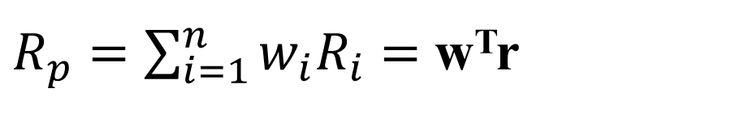
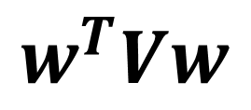
Portfolio Arithmetic with Matrices
$R_{p}=\sum_{i=1}^{n}{w_{i}R_{i}}=$ w^{T}r
=
=
$$w^{T}Vw$$

Slide 18
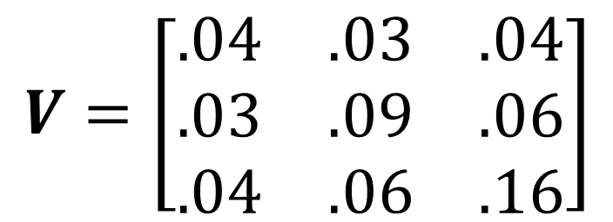
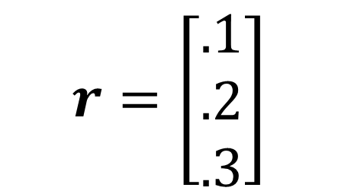
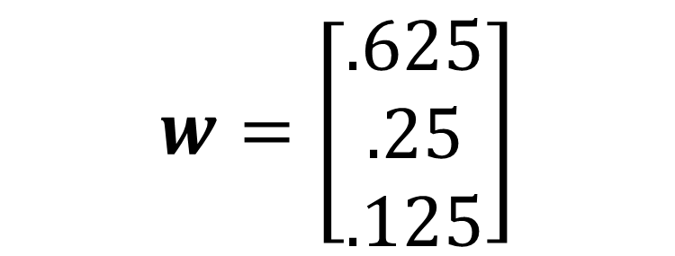
Illustration
$$r=\left[\begin{matrix}.1 \\ .2 \\ .3\end{matrix}\right]$$
$$V=\left[\begin{matrix}.04 & .03 & .04 \\ .03 & .09 & .06 \\ .04 & .06 & .16\end{matrix}\right]$$
$$w=\left[\begin{matrix}.625 \\ .25 \\ .125\end{matrix}\right]$$

Slide 19
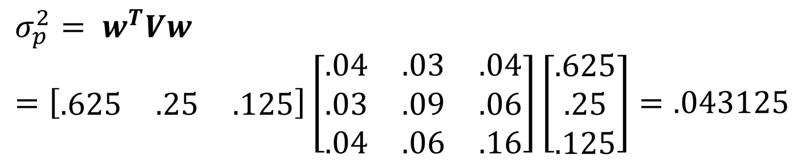
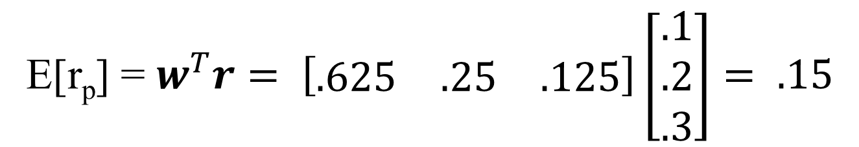
Illustration, continued
E[r_{p}] = $w^{T}r= \left[\begin{matrix}.625 & .25 & .125\end{matrix}\right]\left[\begin{matrix}.1 \\ .2 \\ .3\end{matrix}\right]= .15$
$$σ_{p}^{2}= w^{T}Vw=\left[\begin{matrix}.625 & .25 & .125\end{matrix}\right]\left[\begin{matrix}.04 & .03 & .04 \\ .03 & .09 & .06 \\ .04 & .06 & .16\end{matrix}\right]\left[\begin{matrix}.625 \\ .25 \\ .125\end{matrix}\right]=.043125$$

Slide 20
4.2. The Efficient Set
Dominance occurs when one security or portfolio has both a higher expected return and a lower risk than another or is equal in one and better in the other.
Dominant portfolios are those that are not dominated.
Efficient portfolios are those that are not dominated.
The Efficient Set is comprised of all efficient portfolios.

Slide 21
Indifference Mapping

Slide 22
Efficiency And Dominance
Because investors prefer as much return and as little risk as possible, the most efficient portfolios are those with the following characteristics:
Smaller risk than all portfolios with identical or larger returns and
Greater return than all portfolios with identical or less risk.
One portfolio dominates a second when one of the following three conditions is met:
the first portfolio has both higher return and smaller risk levels than does the second,
both portfolios have identical variance but the first portfolio has a higher return level than does the second, or
both portfolios have identical returns but the first portfolio has a smaller variance than does the second.
A portfolio is dominant if it is not dominated by any other portfolio. Thus, the most efficient portfolios are all dominant.

Slide 23
Construction of the Efficient Frontier
We seek to combine securities into more efficient portfolios.
We seek to combine portfolios into more efficient portfolios.
We seek to maximize portfolio efficiency by maximizing returns and minimizing risk levels.

Slide 24
2-Security Portfolio
B
A

Slide 25
Five 2-Security Portfolios
DE
E
CD
D
BC
C
AB
B
A

Slide 26
Increasingly Efficient Portfolios
Efficient
Frontier
E
DE
CDDE
D
Feasible
Region
CD
BCCD
C
BC
ABBC
B
AB
A

Slide 27

The Risk‑free Asset
The risk‑free return (r_{f}) can be approximated with the short‑term Treasury bill rate.

Slide 28
The Riskless Asset and a Risky Portfolio

Slide 29

Combination of risk-free asset with one of five portfolios of risky assets

Slide 30
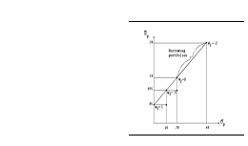
Combinations of risky asset portfolio and the risk-free asset

Slide 31
The Capital Market Line
The best portfolio of risky assets to combine with the risk‑free security lies on the Efficient Frontier, tangent to the line extending from the risk‑free security.
This line is referred to as the Capital Market Line (CML).
We will see that portfolios on the Capital Market Line dominate all portfolios on the Efficient Frontier.

Slide 32
The Capital Market Line

Slide 33
Deriving the Capital Market Line

Slide 34
Applying the Chain Rule

Slide 35
Back to Theta Partials

Slide 36
Our System of Equations
z_{i} =
w_{i}(E[R_{p}]-r_{f})/σ_{p}

Slide 37
Illustration Introduction
r_{f} = .08

Slide 38
Find the Optimal Portfolio
.

Slide 39
Illustration Conclusion

Slide 40
4.3 The Capital Asset Pricing Model
CAPM is a theory of equilibrium in capital markets.
CAPM explains how investors price securities ,

Slide 41
CAPM Assumptions
Capital markets are perfectly efficient, meaning that security prices fully reflect all available information at all times.
Security returns are normally distributed.
All assets are marketable and infinitely divisible.
No restrictions on short‑sales
Investors hold identical expectations.
There exists a risk-free security with no restrictions on borrowing and lending.
Investor planning horizons are for a single time period.

Slide 42
CAPM Derivation: Preliminaries

Slide 43
The Market Price of Risk
λ = (E[R_{m} – r_{f}])/σ_{p}²

Slide 44
Punch Line: The CAPM

Slide 45


CAPM and Beta
The Capital Asset Pricing Model:

Slide 46
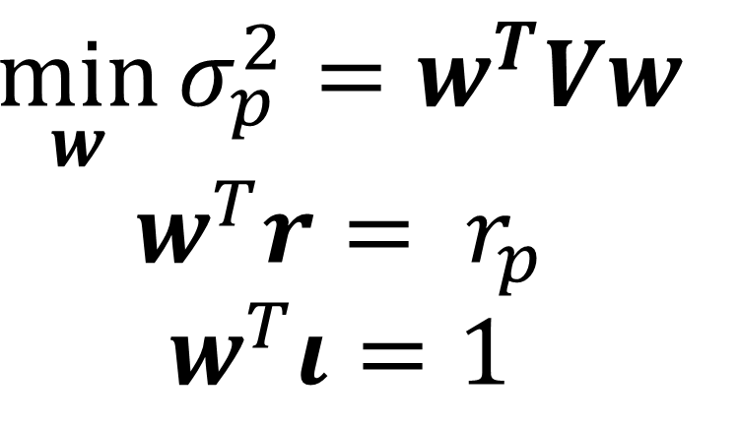
CAPM and LaGrange Optimization
$$\min_{w}{σ_{p}^{2}}=w^{T}Vw$$
$$w^{T}r= r_{p}$$
$$w^{T}ι=1$$

Slide 47
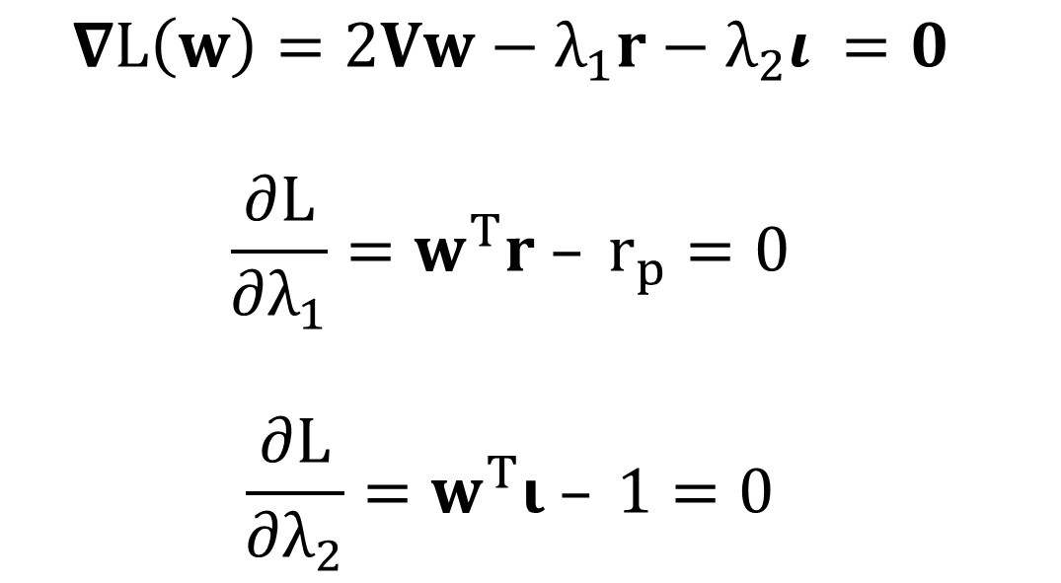
First Order Conditions
$$\left.L=w^{T}Vw− λ_{1}\left(w ^{T}r− r_{p}\right)− λ_{2}(w^{T}ι−1\right)$$
$$∇L\left(w\right)=2Vw−λ_{1}r−λ_{2}ι =0$$
$$\frac{∂L}{∂λ_{1}}=w^{T}r – r_{p}=0$$
$$\frac{∂L}{∂λ_{2}}=w^{T}ι – 1=0$$

Slide 48
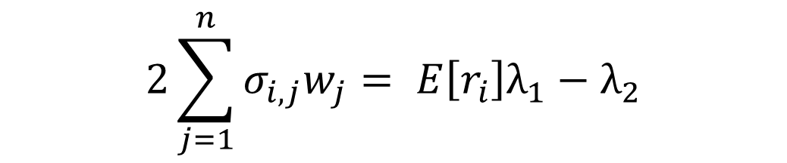
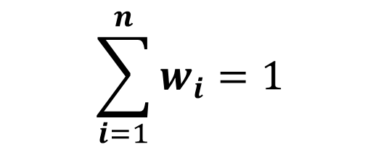
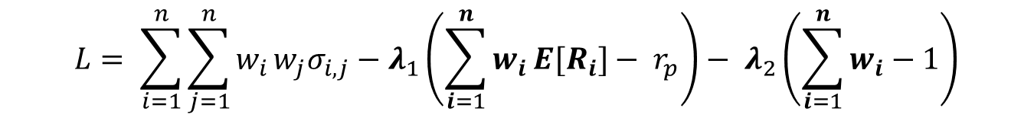
In Other “Words”
$$L= \sum_{i=1}^{n}{\sum_{j=1}^{n}{w_{i}}}w_{j}σ_{i,j}−λ_{1}\left(\sum_{i=1}^{n}{w_{i}}E[R_{i}]− r_{p}\right)− λ_{2}\left(\sum_{i=1}^{n}{w_{i}}−1\right)$$
$$\frac{∂L}{∂w_{i}}=2σ_{i,1}w_{1}+ 2σ_{i,2}w_{2}+ …+ 2σ_{i,n}w_{n}− E\left[r_{i}\right]λ_{1}−λ_{2}=0$$
$$2\sum_{j=1}^{n}{σ_{i,j}w_{j}}= E\left[r_{i}\right]λ_{1}−λ_{2}$$
$$\sum_{i=1}^{n}{w_{i}}=1$$

Slide 49
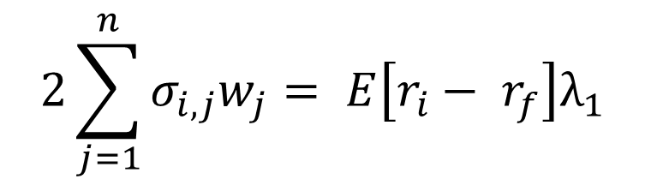

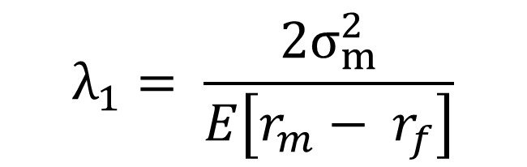
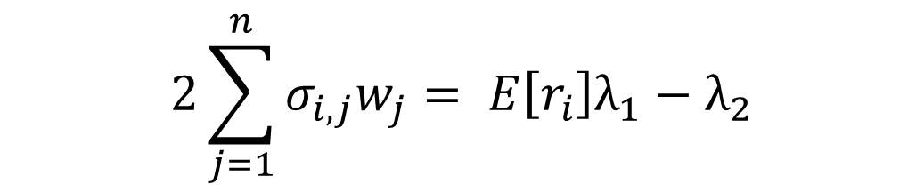
A Few Tricks
$$2\sum_{j=1}^{n}{σ_{i,j}w_{j}}= E\left[r_{i}\right]λ_{1}−λ_{2}$$
$$0= E\left[r_{f}\right]λ_{1}−λ_{2}$$
$$2\sum_{j=1}^{n}{σ_{i,j}w_{j}}= E\left[r_{i}− r_{f}\right]λ_{1}$$
$$2σ_{m,m}= E\left[r_{m}− r_{f}\right]λ_{1}= {2σ}_{m}^{2}$$
$$λ_{1}= \frac{{2σ}_{m}^{2}}{E\left[r_{m}− r_{f}\right]}$$

Slide 50

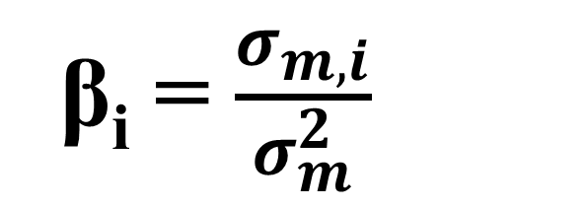
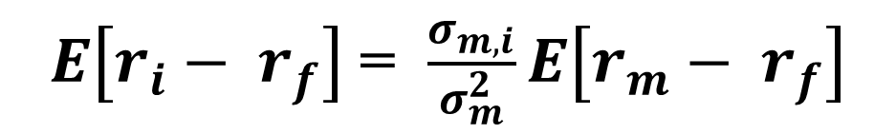
And, Voila!
$$λ_{1}= \frac{{2σ}_{m}^{2}}{E\left[r_{m}− r_{f}\right]}$$
$2\sum_{j=1}^{n}{σ_{i,j}w_{j}}= 2σ_{m,i}=E\left[r_{i}− r_{f}\right]λ_{1}= E\left[r_{i}− r_{f}\right]$ $\frac{{2σ}_{m}^{2}}{E\left[r_{m}− r_{f}\right]}$
$E\left[r_{i}− r_{f}\right]$ = $\frac{σ_{m,i}}{σ_{m}^{2}}E\left[r_{m}− r_{f}\right]$
β_{i} = $\frac{σ_{m,i}}{σ_{m}^{2}}$

Slide 51
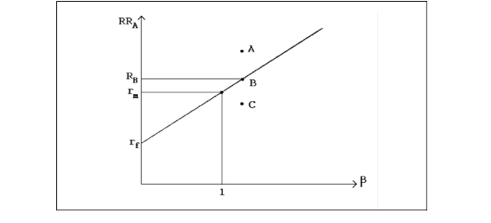
The Securities Market Line

Slide 52
Systematic and Unsystematic Risk
Systematic risk is that portion of a security's risk that is related to variance of the market portfolio.
Unsystematic risk is that portion of a security's variance that is unrelated to risk of the market portfolio.

Slide 53
Portfolio Size and Risk Reduction

Slide 54

Risk‑adjusted Discount Rates

Slide 55
Numerical Illustration
The expected returns of the three assets A, B and C in an economy are .1, .2 and .3, respectively. Their standard deviations are .2, .3 and .4. The returns covariance between assets A and B is .03, the returns covariance between assets A and C is .04 and the returns covariance between assets B and C is .06.

Slide 56
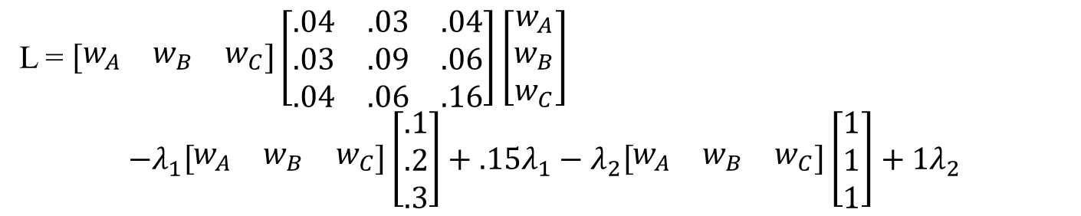
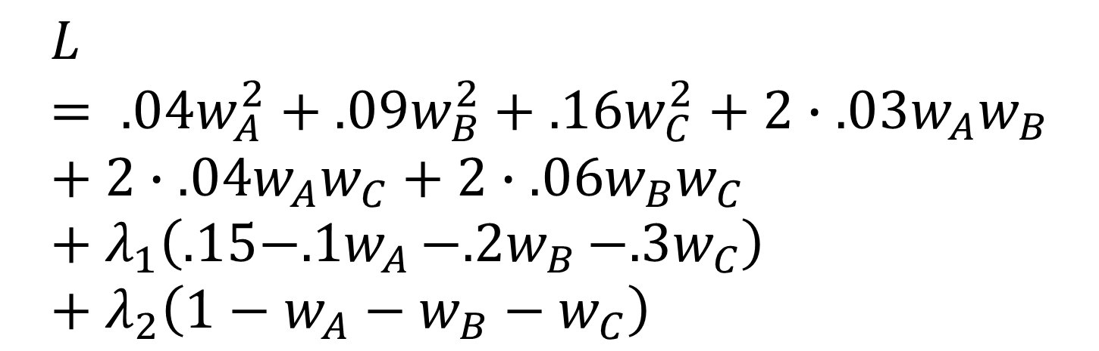
The LaGrangian
$$L= .04w_{A}^{2}+.09w_{B}^{2}+.16w_{C}^{2}+2∙.03w_{A}w_{B}+2∙.04w_{A}w_{C}+2∙.06w_{B}w_{C}+λ_{1}\left(.15−{.1w}_{A}−{.2w}_{B}−.3w_{C}\right)+λ_{2}\left(1−w_{A}−w_{B}−w_{C}\right)$$
or
L = $\left[\begin{matrix}w_{A} & w_{B} & w_{C}\end{matrix}\right]\left[\begin{matrix}.04 & .03 & .04 \\ .03 & .09 & .06 \\ .04 & .06 & .16\end{matrix}\right]\left[\begin{matrix}w_{A} \\ w_{B} \\ w_{C}\end{matrix}\right]$
$$−λ_{1}\left[\begin{matrix}w_{A} & w_{B} & w_{C}\end{matrix}\right]\left[\begin{matrix}.1 \\ .2 \\ .3\end{matrix}\right]+.15λ_{1}−λ_{2}\left[\begin{matrix}w_{A} & w_{B} & w_{C}\end{matrix}\right]\left[\begin{matrix}1 \\ 1 \\ 1\end{matrix}\right]+1λ_{2}$$

Slide 57
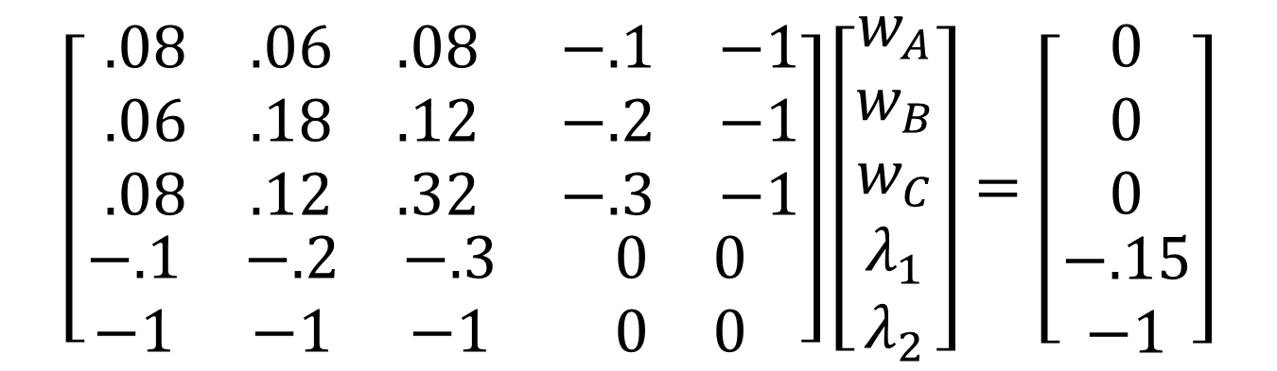
First Order Conditions
$$\left[\begin{matrix}\begin{matrix}.08 & .06 & .08 \\ .06 & .18 & .12 \\ .08 & .12 & .32\end{matrix} & \begin{matrix}−.1 & −1 \\ −.2 & −1 \\ −.3 & −1\end{matrix} \\ \begin{matrix}−.1 & −.2 & −.3 \\ −1 & −1 & −1\end{matrix} & \begin{matrix}0 & 0 \\ 0 & 0\end{matrix}\end{matrix}\right]\left[\begin{matrix}\begin{matrix}w_{A} \\ w_{B} \\ w_{C}\end{matrix} \\ \begin{matrix}λ_{1} \\ λ_{2}\end{matrix}\end{matrix}\right]=\left[\begin{matrix}\begin{matrix}0 \\ 0 \\ 0\end{matrix} \\ \begin{matrix}−.15 \\ −1\end{matrix}\end{matrix}\right]$$
V* w* = o*

Slide 58
Solution
We invert Matrix V* then solve for Vector w*. We find the following weights: w_{A} = .625, w_{B} = .25 and w_{C} = .125; our LaGrange multipliers are λ₁ = .225 and λ₂ = .0525.

Slide 59
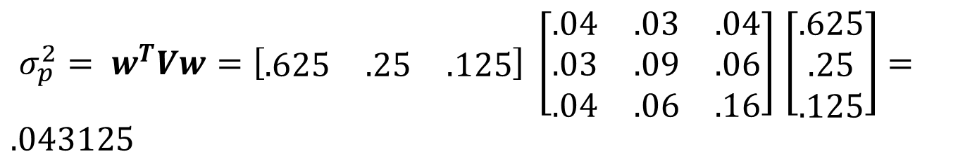
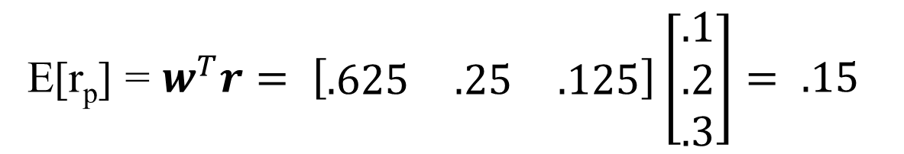
Portfolio Return and Risk
E[r_{p}] = $w^{T}r= \left[\begin{matrix}.625 & .25 & .125\end{matrix}\right]\left[\begin{matrix}.1 \\ .2 \\ .3\end{matrix}\right]= .15$
$σ_{p}^{2}= w^{T}Vw=\left[\begin{matrix}.625 & .25 & .125\end{matrix}\right] \left[\begin{matrix}.04 & .03 & .04 \\ .03 & .09 & .06 \\ .04 & .06 & .16\end{matrix}\right]$ $\left[\begin{matrix}.625 \\ .25 \\ .125\end{matrix}\right]=.043125$

Slide 60
CAPM: Empirical Tests
To what extent does CAPM explain the variation structure of security returns?
  Most earlier tests were quite supportive
  finding linear relationships between stock and market returns
  statistically significant betas
  returns being unrelated to unsystematic returns
However, Roll [1977] made a very convincing argument of the untestability of CAPM, citing inability to correctly discern the market portfolio
Fama and French [1992] were more critical of CAPM, finding:
  Relationship between returns and betas is weak after 1963
  Firm size and Book to Market Equity values caused the significance of beta to disappear in cross-sectional tests with returns.
Nevertheless, the empirical strength of CAPM remains a controversial issue among both academics and practitioners alike.

Slide 61
4.4. Arbitrage Pricing Theory
We’ll start with a few preliminaries.

Slide 62
The Law of One Price
The Law of One Price holds that securities and portfolios that offer the same future cash flows must sell at the same price.

Slide 63
Arbitrage
Arbitrage: the simultaneous purchase and sale of the same or substantially similar asset at different prices.
  succeeds when the prices of purchased assets is less than the prices of sold assets.
  arbitrageurs are highly dependent on low transaction costs and speed of trade execution.
Arbitrageurs seek to profit from violation of the Law of One-Price
An arbitrage portfolio is self-financing, and over time, no additional capital is devoted to or lost from the portfolio.

Slide 64
Arbitrage Pricing Theory
Arbitrage Pricing Theory is a theory of capital markets equilibrium.
APT holds that security returns are linearly related to a set of independent factors.

Slide 65
Mathematical Underpinnings
Assume that each vector x in a set {X} of n-1 vectors {x₁, x₂, ..., x_{n-1}} is orthogonal (e.g., x ⊥ w) to some other vector w. That is, x₁^{T}w = 0, x₂^{T}w = 0 and so on.
Further assume that because each of the n-1 vectors in X is orthogonal to w, an n^{th} Vector x_{n} must also be orthogonal to w. Thus, x^{T}w = 0. That is, assume that the subset of n-1 vectors from set {X} being orthogonal to w implies that x_{n} must also be orthogonal to w.
Result: Vector x_{n} must be a linear combination of vectors {x₁, x₂, ..., x_{n-1}}.

Slide 66
Illustration
Let:
w = security weights in an arbitrage portfolio
a = security sensitivities to r_{f}
b, c = security sensitivities to factors I_{b} & I_{c}
d = security expected returns

Slide 67
Numerical Illustration
The riskless return rate and two-factor risk premia are determined to be as follows: δ₀ = .05 = r_{f}, δ₁ = .04, δ₂ = .01.

Slide 68
Numerical Illustration, continued
δ₀ = .05 = r_{f}, δ₁ = .04, δ₂ = .01.
What would be the value of a security:
whose expected total payoff in one year is $100
its Beta (b₁) with δ₁ is 2 and its Beta (b₂) with δ₂ is .8
First, we find its expected return to be (.05 + 2×.04 + .8×.01) = .20.
Thus, its current value is $100/1.2 = 83.333.

Slide 69
APT Applications
Applying APT is often as easy as:
establishing relevant pricing factors
Using an OLS Regression to establish factor loadings

