Slide 1
III. SECURITIES TRADING SUPPORT

Slide 2
3.1. Securities Trading Infrastructure
Professional traders need to be better-informed with respect to the “nuts and bolts” of their trading activities.
Trader activities all occur within the financial market infrastructures, sometimes called the “plumbing for financial markets” that:
  provide key services that are critical to the smooth and reliable functioning of markets
  institutions providing these services often are referred to as financial market utilities, which include
    central counterparties
    institutions that provide reliable transfer, payments, clearing and settlement systems

Slide 3
3.2. Price and Quotation Systems
Fragmentation occurs when identical securities trade in multiple markets.
Fragmentation can hinder market transparency and efficiency.
Price and quotation systems can alleviate negative effects of fragmented markets.
This is the purpose of the National Market System.

Slide 4
Market Fragmentation
Traders can subscribe to direct price and quote data feeds from any of the various U.S. exchanges
Traders often have to contend with the same securities being traded in multiple venues.
That is, U.S. markets are fragmented, which
  reduces informative quality of pricing
  reduces market efficiency
  can hinders the ability of traders to obtain the best possible prices
Costs of subscribing to and analyzing multiple data feeds are prohibitive for most traders.

Slide 5
National Market System
The U.S. Congress has made several efforts to legislate reductions in market fragmentation and its harmful effects on investors without hindering market competition.
The U.S. Congress has encouraged made efforts to improved competition among markets
the Securities Act of 1975 amended the Securities Exchange Act of 1934 to facilitate development of a national market system intended to
  increase competition, efficiency, and price transparency
  promote best execution and order interaction.
In this system, exchanges list security prices simultaneously on relevant quotation and trade reporting systems.
The purpose of this national market system: to ensure that investors would receive the best possible executions

Slide 6
Price and Quotation Institutions
The Securities Industry Automated Corporation (SIAC), owned by NYSE, maintains the primary systems for disseminating price and quote information to the public.
Securities Information Processor (SIP): The National Market System's price and quote reporting systems. The system operated and maintained by the NYSE is simply called the Securities Information Processor (SIP).
Consolidated Tape (CTA): High-speed electronic system maintained by SIAC for reporting transaction prices and volumes for securities on all U.S. exchanges and markets.
Consolidated Quotations System (CQS): Provides traders with price quotes through SIAC from the various exchanges and FINRA and calculates the NBBO. The CQS does not time delay as the Consolidated Tape can during periods of heavy volume.

Slide 7
SIPs
SIPs link U.S. markets by collecting, consolidating and compiling from all relevant trading venues into a single continuous data feed:
  all trade prices
  all bid/ask quotes
  intraday highs and lows
  the NBBO
SIPs mitigate the adverse effects of market fragmentation while retaining competition among trading venues
Registered exchanges and certain other markets are required to provide quotation and transaction data to a designated SIP.

Slide 8
U.S. Equity SIPs
The two U.S. equity SIPs are:
  the Consolidated Tape Association (CTA), overseen by the NYSE and
  Unlisted Trading Privileges (UTP), overseen by Nasdaq.
These SIPs combine and disseminate prices and quotes through three SIP networks:
  Tape A governed by CTA, which reports for NYSE securities regardless of where they trade,
  Tape B, also governed by CTA, which reports for exchanges, ATSs and venues other than the NYSE and Nasdaq, and
  Tape C, governed by UTP for securities listed on Nasdaq
The CTA’s two reporting systems are:
  the Consolidated Tape System (CTS) that reports transaction prices and volumes and
  the Consolidated Quotations System (CQS) that provides quotes data.
Both CTS and CQS data are combined into network Tapes A, B and C and sent to subscribers.

Slide 9
3.3. Brokerage Operations
Brokerage firms appear as the face of trading processes to most investors.
Securities brokers traditionally received commissions for their execution services
They often provide or provided a variety of other services to their clients.

Slide 10
SIPC
Securities Investors Protection Corporation (SIPC) is analogous to FDIC in that it insures investors' account for up to $500,000 in securities and $100,000 in cash
The insurance is only effective when a brokerage firm fails.
SIPC coverage is very limited.

Slide 11
SIPC Resources
SIPC assesses its members annually at a rate of .0015 of net operating revenues as of 2021.
These assessments are contributed to a default fund, which as of year-end 2020, had reached approximately $3.9 billion.
SIPC also maintains a $2.5 billion line of credit with the U.S. Treasury.
Since 1970, SIPC has injected $3.1 billion from its fund to cover investor losses, enabling it to recover approximately $141.8 billion on behalf of 773,000 insured investors.

Slide 12
Brokerage Offices
Most securities brokerage firms operate front, middle, and back offices:
  Front-office personnel produce revenues
  Middle-office personnel directly support front-office staff

Slide 13
Back Office Operations
Back-office personnel provide support services behind the scenes:
  IT specialists, accountants, operations staff, human resources staff, office managers, customer service representatives, and regulatory compliance staff.
Back-office activities include:
  trade confirmation,
  clearing,
  settlement functions, usually conducted with the assistance of clearing institutions
  margin calculations,
  exercise and settlement for derivative securities
  records and account maintenance,
  software and information technology, and data provision
  might include efforts related to strategic planning for the brokerage firm.

Slide 14
3.4. Clearing and Settlement
Clearing refers to activities resulting in the settlement of claims of financial institutions against other financial institutions.
The general clearing process involves three primary tasks:
  trade confirmation: recording and desemenating details of the trade
  trade comparison (matching of trades by involved institutions) and
  trade settlement (delivery of securities or comparable book entry).

Slide 15
Clearing Operations
The operations department of a financial institution, often referred to as the institution’s back office, is responsible for handling or overseeing the clearing and settlement processes.
A clearing firm is authorized by a clearing house to manage trade comparisons and other back-office operations.
Leading clearing firms include Pershing, LLC, JPMorgan Clearing Corp. and National Financial Services, LLC.

Slide 16
Clearing Houses
A clearing house clears transactions for a market such as the NYSE.
  A clearing house facilitates the trade settlement between two clearing firms and seeks to ensure that the clearing firms honor their trade settlement obligations.
  The clearing house will typically guarantee the obligations of its member firms.

Slide 17
Novation
Novation: The process by which the clearing house steps into a transaction to be settled by its members and assumes the settlement obligations of both counterparties.
  Novation leads the clearing house to, in effect, become the counterparty to both sides of every transaction
  The clearinghouse, acting as a central counterparty, acts as the counterparty for each party to every transaction, and assumes all credit risk.

Slide 18
Clearing
In the United States, the National Securities Clearing Corporation (NSCC, a division of the Depository Trust and Clearing Corporation) is the major clearing agent for equity markets.
Its primary facility for clearing is the Securities Industry Automated Corporation (SIAC).
Clearing generally refers to confirmation and comparison.

Slide 19
Clearing Process
Confirmation is the first step of the clearing process.
  Buyers and sellers record trade details.
  Brokers and dealers receive confirmations that the trade has been executed and pass on details to clients.
  The typical confirmation document received by the client reports the stock's name and CUSIP number, the number of units traded, the security price, the broker commission and other fees, along with trade and settlement dates.
Trade comparison is the second step in the clearing process.
  Comparison matches counterparties
  Trades are compared and are said to be cleared when the counterparties’ records are identical.
  Out-trades in futures markets or DK’s (Don’t Knows) in other markets, which are trade reports with discrepancies.

Slide 20
Netting
Netting is the simplification process used by clearing firms:
  add all of an institution’s purchases of each security,
  add the sales of each security
  deducting sells from buys for each security to determine the net change in holdings of that security for the institution and
  compute the net cash flows associated with all transactions.
The NSCC uses an automated system through the Securities Industry Automation Corporation (SIAC) to “net down” or reduce the number of trading obligations that require financial settlement.
At the end of the netting process, the NSCC delivers to each brokerage firm settlement instructions.

Slide 21
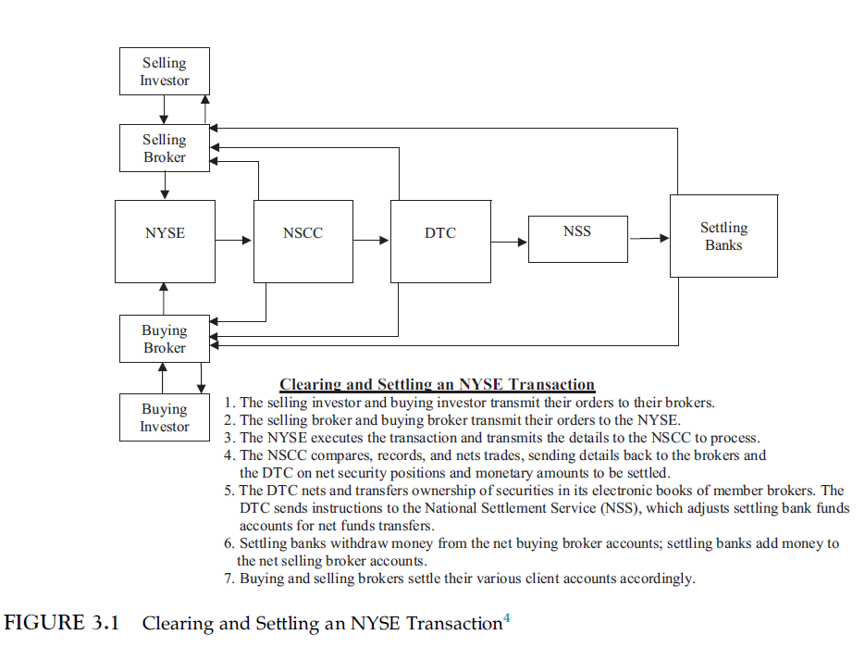
Clearing Diagram

Slide 22
Settlement
Trade settlement occurs when buyers receive securities and sellers receive payment.
Modern settlement of trades normally takes place in electronic book entry form.

Slide 23
The DTCC
Settlement of a U.S. equity trade is completed when the DTCC transfers the ownership of the shares in the record keeping system and transfers money between firms with net credits and net debits.
The Depository Trust & Clearing Corporation (DTCC), holds stock certificates of member firms, registering them in member names.
  In 2018, the DTCC processed over 1.4 billion transactions per day.
  The DTCC settled more than $2.329 quadrillion in securities transactions in 2020, including equities, fixed income instruments, mutual funds, insurance products, etc.

Slide 24
Settlement Details
In the 1960s, clearing involved the physical transfer of paper securities and checks.
Equity securities are held in street name, meaning that securities are held in the names of brokers, who, in turn, maintain their own records of ownership in client accounts.
At present, the SEC requires that settlement occur within two days (T+2) after most transactions.
The DTCC provides clearing services at low cost, averaging approximately $.0000066 per share.

Slide 25
Margin, Collateral, and Hypothecation
Settlement risk in the market is mitigated by imposing margin or collateral requirements, collectively known as performance bonds.
Hypothecation is the pledge of assets as collateral for debt or other obligation.
Margin is the pledge of funds by traders to ensure they fulfill their trading obligations.

Slide 26
3.5. Other Financial Market Utilities and Functions
Companies send dividend payments to DTC’s affiliate Cede & Co., which distributes payments through its automated Dividend Service to appropriate members (brokerage firms, clearing firms, and banks).
A transfer agent (share registry in the U.K., Australia, and New Zealand) maintains records of ownership and transfers of shares and other securities issued by a publicly traded company.

Slide 27
3.6. Systemically Important Financial Market Utilities
A systemically important financial market utility (SIFMU) is a non-bank financial institution providing transfer, clearing and settlement services whose failure has the potential to trigger a financial crisis.
Systemically Important Financial Market Utilities are clearinghouses or payments institutions.
Clearinghouses need to match long positions in securities and instruments against short positions in the same instruments.
  Every buy is matched with a sale.
  Exact matching provides protection against clearinghouse risk.

Slide 28
Default Waterfall
A central counterparty’s default waterfall stipulates the sequence of resources to protect the market and its participants from broker and clearing firm defaults.
Although rare, clearinghouses do fail.
Should a SIMFU experience a stress event, the steps are, in order to:
  draw from the accounts of and to demand additional margin from members or specific members associated with the stress.
  draw from the SIMFU’s own capital
  draw from the SIMFU’s mutual default fund
  most clearinghouses provide for their members to inject additional capital as needed.
Without detailed recovery and resolution plans, additional lines of defense or resolution, including potential government bailouts, tend to be rather ambiguous.

